Slide 1
PARTICIPANT STUDY DECK
QuantathonV3 · Clemson University · September 2026
EARTHQUAKE-Q
A Quantum–Classical Earthquake-Forecasting Challenge
Seismology
Machine Learning
Quantum
Honesty over hype
Notes:
Welcome. This deck is a complete, self-paced walkthrough of the real Earthquake-Q reference solution — real data, real numbers, real findings.

Slide 2
READ ME FIRST
How to use this study deck
01
It is self-paced
Nine modules, ~10–14 slides each. Read them in order the first time — they build on each other. Budget 3–4 focused hours for a full pass.
02
It teaches the real answer
Not a teaser. Every method, parameter, and blind-window number is the actual reference solution. If you competed and did not solve it, this is where you learn how.
03
It has exercises
Look for the amber “Try it yourself” cards. Work them before turning the page; each module ends with an Answer Key.
04
It rewards a mindset
The hardest lesson is not quantum computing — it is intellectual honesty. The “Honesty checkpoint” cards are the point.
Front matter
Earthquake-Q · QuantathonV3
2

Slide 3
THE ROAD AHEAD
Nine modules, one honest forecast
1
The Problem
2
The Raw Data
3
Seismology You Need
What we forecast, and why it's hard
Five live sources, and what leaks
Gutenberg–Richter, completeness, ETAS
4
Feature Engineering
5
Validation & Calibration
6
Quantum Methods
Raw streams → a design matrix
The part that separates winners
Encoding, kernels, VQC, plateaus
7
The Honest Verdict
8
The Naive Control
9
Deploy & Reflect
Does any of it beat 5-param physics?
What raw data alone already buys
A real forecast, and the lessons
Each module ends with exercises and a full answer key.

Slide 4
1
MODULE 1
The Problem
What exactly are we forecasting, and why is it genuinely hard?
IN THIS MODULE
The precise forecasting target and its units
Why this is a probability problem, not a prediction problem
The grid, the windows, and the scoring philosophy
Why a high AUC can still be a failing answer

Slide 5
THE TARGET
One question, asked 23,265 times
For every cell on a map of the central & eastern United States, and for each of 15 consecutive 30-day windows, answer one question:
“What is the probability that at least one magnitude ≥ 2.0 earthquake occurs within 100 km of this cell during this window?”
That is a calibrated probability in [0, 1] — not a yes/no, not a magnitude, not a time.
1,551 grid cells × 15 windows = 23,265 probabilities per submission. The window spans 2025-01 to 2026-04.
Spatial unit
0.5° grid cells over 25–50°N, 65–90°W — the seismically active eastern US.
Temporal unit
Fifteen 30-day windows, forecast from a single fixed information cutoff (2025-01-01).
What counts
Any M≥2.0 event within 100 km. Rare: only ~9.5% of cell-windows are positive.
Module 1 · The Problem
Earthquake-Q · QuantathonV3
5
Notes:
The target is a calibrated probability. Emphasize: rare events, so calibration matters more than raw accuracy.

Slide 6
WHY IT'S HARD
Four things that make this a real problem
1 · Rarity
3 · Leakage is easy
9.5% base rate. A model that always predicts 'no' is 90% accurate and completely useless.
With time-series data, it is trivially easy to let the future leak into the past and fool yourself.
2 · You build everything from a base solution
4 · Physics is strong
We ship an example solution and raw data.
A 5-parameter statistical model of aftershocks is shockingly hard to beat. You must know it exists.
Module 1 · The Problem
Earthquake-Q · QuantathonV3
6
Notes:
These four difficulties structure the whole competition. Rarity → calibration. Raw data → craft. Leakage → validation. Physics → humility.

Slide 7
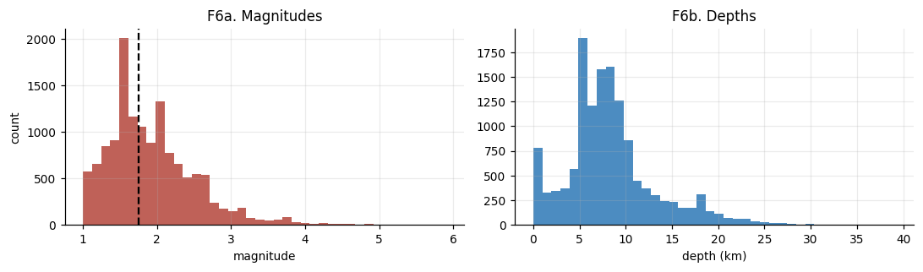
THE TARGET, VISUALIZED
Most cells are almost never active
Class balance across the modelling sets. The positive class (a qualifying earthquake occurs) is rare and roughly stationary across train / calibration / test.
Takeaway: Because positives are rare, accuracy is a trap. The whole game is assigning well-calibrated probabilities to rare events — and proving you did.
Module 1 · The Problem
Earthquake-Q · QuantathonV3
7
Notes:
This is the real class-balance figure from the FULL run. Rarity is why we score information gain and calibration, not accuracy.

Slide 8
HOW WE SCORE
Information gain, not accuracy
We score every forecast by how much it beats two references, in bits per prediction:
Information Gain (IG) = (log-loss of the reference) − (log-loss of your forecast). Positive means you carry real information beyond the reference.
Reference 1 — Climatology:
the historical base rate. Beating it means you know where and when, not just how often.
Reference 2 — ETAS:
a fitted physics model of earthquake triggering. Beating it means your ML added something physics didn't already know.
IG vs climatology
The headline skill number. The reference reaches +0.136 bits on the blind window.
IG vs ETAS
The hard bar. The reference clears it by only +0.002 bits — statistical parity.
Calibration (ECE)
Are your stated probabilities honest? Expected Calibration Error must be < 0.02.
Module 1 · The Problem
Earthquake-Q · QuantathonV3
8
Notes:
Two references. Climatology is the easy floor; ETAS is the hard one. Introduce the +0.136 / +0.002 numbers here as a preview.

Slide 9
✓
HONESTY CHECKPOINT
A high AUC can be a failing answer
Because earthquakes cluster in the same few zones year after year, almost any model that learns 'where' gets an ROC-AUC around 0.85. That number feels impressive and means almost nothing here.
AUC measures ranking. It does not measure whether your probabilities are true.
A model can rank cells perfectly and still be badly overconfident — stating 0.9 where the truth is 0.3. That model has a great AUC and a terrible, useless forecast.
So we treat AUC as a screening check, and judge on information gain with calibration.
“The spatial prior gives ~0.85 AUC to almost any model that finds the active zones. AUC is a screening check, not the prize.”
Notes:
Critical framing. Teams that optimize AUC will be misled. This checkpoint plants the flag early.

Slide 10
TRY IT YOURSELF · 1.1
Before you model: think about the target
The task
Write down, in one sentence each, why each of these naive approaches fails: (a) predicting the single most likely magnitude per cell; (b) predicting yes/no with a 0.5 threshold; (c) reporting accuracy as your headline metric.
A colleague proposes: 'I'll get 91% accuracy by always predicting no earthquake.' Compute their information gain versus climatology. What does the number tell you?
If positives are 9.5% of cell-windows, what is the Shannon entropy of the target (in bits)? This is the ceiling an oracle could achieve.
Hints
IG versus climatology compares your log-loss to climatology's log-loss. If you *are* climatology, what is the difference?
Entropy of a Bernoulli(p): −p·log₂p − (1−p)·log₂(1−p).
Work this before turning the page. The answer key is at the end of the module.
Module 1 · The Problem
Earthquake-Q · QuantathonV3
10
Notes:
Exercise 1.1 forces engagement with the metric before any modeling. Answers in the module-1 key.

Slide 11
ANSWER KEY · MODULE 1
Check your work
1.1(a–c) — why the naive approaches fail
(a) A single magnitude throws away the whole probability distribution; the target is P(any M≥2), not a point magnitude.
(b) A 0.5 threshold on a 9.5% base rate predicts 'no' everywhere — zero recall, useless forecast.
(c) Accuracy rewards predicting the majority class; 90.5% accuracy is achievable with zero skill.
1.1 — information gain of 'always predict no'
Predicting a constant 0 (clipped) or the base rate is exactly climatology, so its IG vs climatology is 0.000 bits. High accuracy, zero information. That is the entire point of scoring on IG.
1.1 — entropy ceiling
H = −0.095·log₂(0.095) − 0.905·log₂(0.905) ≈ 0.453 bits. No forecaster, however good, can exceed ~0.45 bits of information gain on this target. The reference achieves ~0.136 — about 30% of the ceiling.
Module 1 · The Problem
Earthquake-Q · QuantathonV3
11
Notes:
Module 1 answer key.

Slide 12
2
MODULE 2
The Raw Data
Five live sources, delivered raw. You build everything else.
IN THIS MODULE
The five geophysical data streams and where they come from
Why we ship raw data and hold nothing back
The train / test / judge split and the frozen cutoff
Data leakage: the mistake that quietly wins, then loses

Slide 13
WHAT YOU GET
Five raw streams, three CSV files
Seismic catalog (USGS)
Earth tides (ephemeris)
Every M≥1.0 event: time, lat, lon, depth, magnitude. The signal lives here.
Tidal potential and lunar phase — small periodic stress on faults.
Geomagnetic (GFZ)
GPS / GNSS (Nevada Lab)
Daily ap and Kp indices — a proposed (weak) earthquake trigger.
Daily station positions — crustal strain accumulation near the fault zones.
Solar (GFZ)
How it ships
F10.7 radio flux and sunspot number — solar activity, tested as a driver.
Three tidy long-format CSVs — train, test, judge.
Module 2 · The Raw Data
Earthquake-Q · QuantathonV3
13
Notes:
Five sources. The catalog carries almost all the signal; the other four are honest near-nulls, which is itself a finding teams should discover.

Slide 14
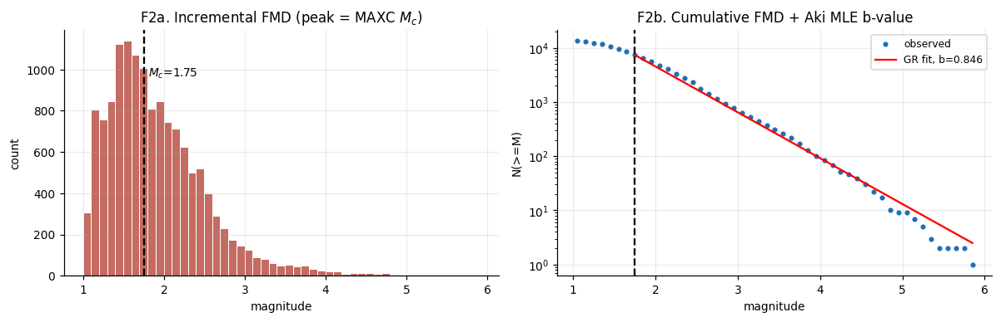
THE FORCING STREAMS
Four candidate drivers, plotted raw
Geomagnetic, solar, and tidal forcing time series as delivered. Part of the challenge is discovering — honestly — that these add almost nothing over the seismic catalog.
Takeaway Including a data stream because it 'might matter' is not analysis. The ablation study (Module 8) shows these four streams add ≈ 0 bits. Reporting that honestly is worth points.
Module 2 · The Raw Data
Earthquake-Q · QuantathonV3
14
Notes:
Real forcing-stream figure. Sets up the later ablation result that geomag/solar/tidal/GPS are near-nulls.

Slide 15
THE SPLIT
Train, test, and a sealed judge set
The information cutoff is frozen at 2025-01-01. Every feature you build must use only data from before its issue date — no exceptions.
Train:
1990 → 2022. Distributed to you. Fit models here.
Test:
2022 → 2025. Distributed. Tune and select here.
Judge:
2025-01 → 2026-04. Held back. Your forecast is scored on this window you would have never seen (but for the Quantathon, it’s provided for you up front)
271,207 rows
train CSV — 35 years of five interleaved raw sources.
48,328 rows
test CSV — the 3-year tuning window.
17,979 rows
judge CSV — keep it sealed until your scoring. This is the real exam.
Module 2 · The Raw Data
Earthquake-Q · QuantathonV3
15
Notes:
The temporal split is the backbone of leakage safety. Cutoff frozen; judge sealed. Row counts are the real frozen-dataset numbers.

Slide 16
✓
HONESTY CHECKPOINT
Leakage: the mistake that wins, then loses
Data leakage is when information that would not be available at forecast time sneaks into your features or your validation. With time-series data it is astonishingly easy.
The tell: your cross-validation score is spectacular, and your blind score collapses.
Three classic leaks: (1) a feature that counts a cell's own future aftershocks; (2) a label window that overlaps the feature window; (3) shuffled k-fold cross-validation that scatters near-duplicate neighbors across folds.
There are no planted traps in this challenge. Every leak is one you create — and one you can prevent.
“A team reporting a blind score far below its own validation is leaking. That gap is the single most diagnostic number a judge can compute.”
Notes:
Leakage is the #1 way strong teams fail. Name the three modes; they recur in Module 5.

Slide 17
TRY IT YOURSELF · 2.1
Spot the leak
The task
For each feature below, decide if it leaks when computing the forecast for cell C, issued at time T: (a) count of M≥3 events within 50 km in the 30 days before T; (b) count within ±15 days of T; (c) distance from C to the nearest fault; (d) the mean magnitude of the next 5 events after T.
You split (cell, date) rows randomly into 5 folds and get AUC 0.94 in CV but 0.83 on test. Name the leak and the fix.
Why does fitting your feature scaler on train + test together count as leakage, even though you never touch the labels?
Hints
The rule: at issue time T, could you actually compute this number using only data with timestamp < T?
Adjacent grid cells on adjacent dates are near-duplicates. What does random shuffling do to them?
Work this before turning the page. The answer key is at the end of the module.
Module 2 · The Raw Data
Earthquake-Q · QuantathonV3
17
Notes:
Exercise 2.1 drills leakage recognition — the highest-leverage skill in the whole competition.

Slide 18
ANSWER KEY · MODULE 2
Check your work
2.1 — spot the leak (a–d)
(a) No leak — uses only the 30 days before T. Legitimate.
(b) LEAKS — the ±15-day window includes 15 days after T, which you could not know at issue time.
(c) No leak — distance to a fault is static, known at any time.
(d) LEAKS badly — 'the next 5 events' is pure future information; this is the target in disguise.
2.1 — CV 0.94, test 0.83
Shuffled k-fold on spatiotemporal rows: neighboring cells/dates are near-duplicates, so each fold validates on near-copies of its training rows. Fix: split by time (or by contiguous spatial blocks), never randomly. Validate on the future, as you will be scored.
2.1 — why global scaling leaks
Fitting a scaler (or PCA, or feature selection) on train+test lets the test distribution influence the transform applied to training data. Distributional information bleeds across the temporal boundary. Fit every preprocessing step on train only, then apply it forward.
Module 2 · The Raw Data
Earthquake-Q · QuantathonV3
18
Notes:
Module 2 answer key.

Slide 19
3
MODULE 3
Seismology You Need
Three ideas from earthquake science that decide the whole challenge.
IN THIS MODULE
Gutenberg–Richter: how earthquake sizes are distributed
Magnitude of completeness: the subtle trap that biases everything
ETAS: the 5-parameter physics model you must beat
A real data pathology — and the task it creates for you

Slide 20
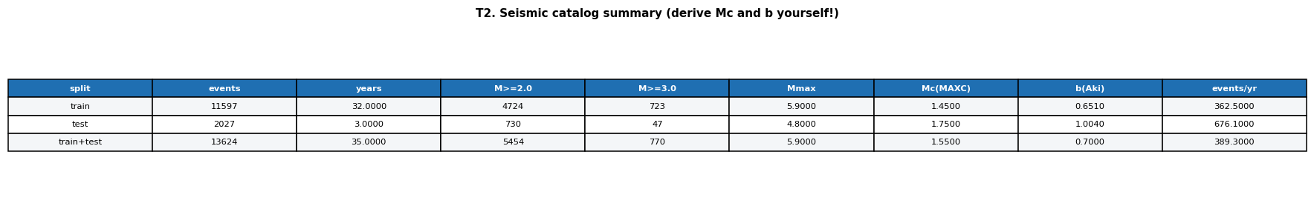
LAW #1
Gutenberg–Richter: sizes follow a straight line
Earthquake magnitudes obey a remarkably clean statistical law:
log₁₀ N(≥M) = a − b·M
N(≥M) is the number of events of magnitude M or larger. Plot it on a log axis against magnitude and you get a straight line.
The b-value (the slope) is ~1.0 worldwide.
It says small quakes vastly outnumber large ones: each unit drop in magnitude gives ~10× more events.
For the central & eastern US, b should land near 0.9–1.0. If you compute something far from that, you have made an error — usually the one on the next slide.
Gutenberg–Richter fit to the real catalog. The slope is the b-value; the bend at the low-magnitude end is the completeness limit.
Module 3 · Seismology You Need
Earthquake-Q · QuantathonV3
20
Notes:
GR is the foundation. b≈1. Deviations signal a completeness problem — the perfect setup for the next slide.

Slide 21
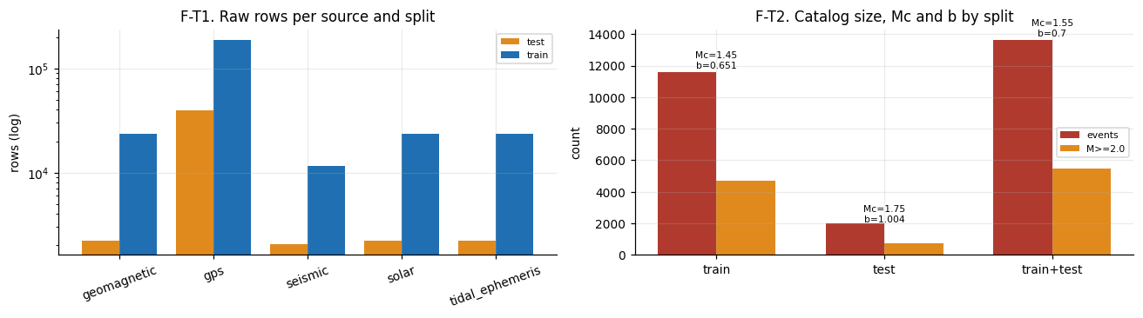
LAW #2 — THE TRAP
Magnitude of completeness (Mc)
Small earthquakes are under-recorded — too weak for distant stations. Below some magnitude Mc, your catalog is incomplete.
If you fit Gutenberg–Richter using events below Mc, the missing small quakes flatten the line and bias the b-value downward. This is the single most common mistake in the whole challenge.
The reference found Mc = 1.75 (modern era) → b = 0.846.
A naive fit on the full catalog gave Mc ≈ 1.45 → b ≈ 0.65 — a value that is physically implausible for this region, and the tell that Mc was set too low.
Completeness magnitude drifts over time as the network densifies. Estimating Mc on the modern era and adding a safety margin (MAXC + 0.2) is the fix.
Module 3 · Seismology You Need
Earthquake-Q · QuantathonV3
21
Notes:
Mc is THE trap. Under-estimating it biases b low. Real numbers: Mc=1.75, b=0.846 correct; 1.45/0.65 wrong.

Slide 22
WHY MC MATTERS
One parameter, everything downstream
1.75
0.846
0.65
Adopted Mc (modern-era MAXC + 0.2)
Resulting b-value — physically sensible for the eastern US
The wrong b from a too-low Mc — a red flag, not a finding
Every b-value feature, every ETAS fit, and every completeness-dependent count inherits your choice of Mc. Get it wrong and a plausible-looking pipeline is quietly built on sand. This is why the reference reports three Mc estimators side by side and adopts the conservative one.
Module 3 · Seismology You Need
Earthquake-Q · QuantathonV3
22
Notes:
Stat slide hammering the Mc lesson. The wrong number looks like a finding; it's an artifact.

Slide 23
LAW #3 — THE BAR
ETAS: the physics you must beat
Most earthquakes trigger others. ETAS (Epidemic-Type Aftershock Sequence) turns that into a forecast with just five parameters:
λ(t) = μ + Σ K·e^{α(mᵢ−Mc)} · (t−tᵢ+c)^{−p}
μ = background rate · K = productivity · α = how strongly big quakes trigger · c, p = Omori aftershock decay.
Fit those five numbers by maximum likelihood to the catalog — never to the labels — and you have a forecast that is startlingly hard to beat.
This is the reference's hard baseline. On the blind window it reaches +0.134 bits over climatology.
5 parameters
Fitted by MLE on the catalog. No labels, no features, no ML.
μ, K, α, c, p
Background, productivity, magnitude-sensitivity, and Omori decay (c, p).
The bar to beat
A 373-feature ML pipeline beats it by only +0.002 bits. Respect the physics.
Module 3 · Seismology You Need
Earthquake-Q · QuantathonV3
23
Notes:
ETAS is the intellectual center of the challenge. Five parameters, fitted to the catalog, extremely strong out of sample.

Slide 24
✓
HONESTY CHECKPOINT
A real pathology: why α pinned near zero
When the reference fit ETAS freely, α — the magnitude-sensitivity of triggering — came out near 0.06, far below the tectonic value of ~0.8–1.0.
α ≈ 0 means triggering barely depends on magnitude. In the eastern US that is a fingerprint of non-tectonic events: quarry blasts and injection swarms that cluster like aftershocks but don't scale with size.
The reference does not hide this. It fits three ETAS variants, flags the bound-pinning out loud, and runs a declustering diagnostic to quantify the contamination.
This is what honest modeling looks like: when a parameter does something strange, you investigate the data, not paper over it.
“α ≈ 0 is a real finding about the catalog, not a bug. Declustering the catalog and refitting is one of the highest-value tasks you can attempt.”
Notes:
The α-pinning story is a gift: it shows honest modeling and hands contestants a real open task.

Slide 25
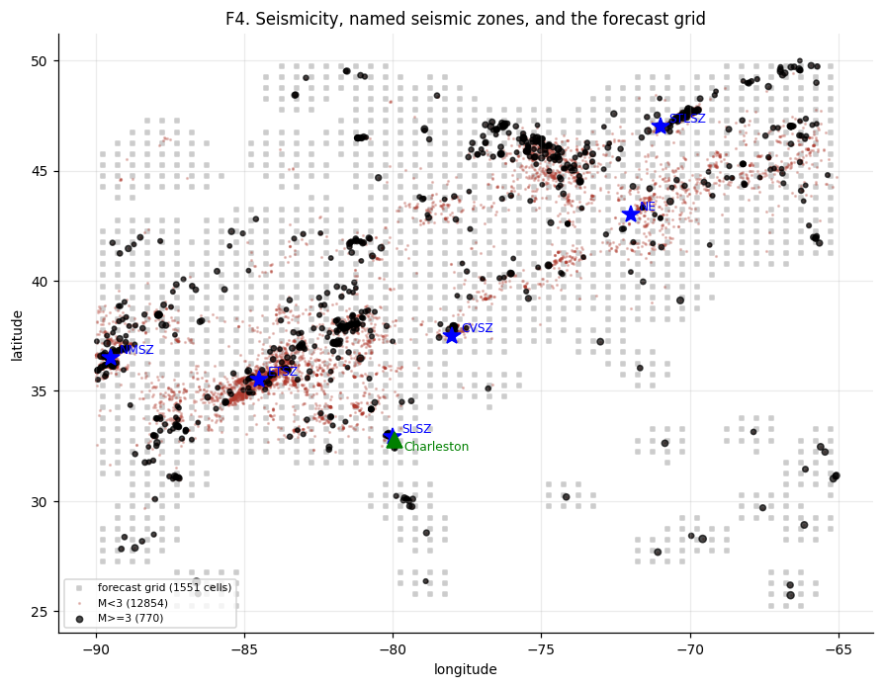
INVESTIGATING THE PATHOLOGY
The declustering diagnostic
Three checks for non-tectonic contamination: time-of-day, day-of-week, and space before/after window declustering. On this catalog there is no strong daytime or weekday excess, so α≈0 points to swarm clustering rather than blasts — and windowing still removes ~20% of events as dependent.
Takeaway The diagnostic doesn't preordain an answer — it shows you how to check. That is the difference between asserting 'blasts!' and demonstrating what the data actually supports.
Module 3 · Seismology You Need
Earthquake-Q · QuantathonV3
25
Notes:
Real declustering figure. Model the scientific posture: check, don't assume.

Slide 26
TRY IT YOURSELF · 3.1
Reason about the physics
The task
You fit Gutenberg–Richter and get b = 0.62 for the eastern US. List two things you would check before believing it, in priority order.
ETAS has a background term μ and a triggering term. In a region with a big aftershock sequence last month, which term dominates this month's forecast? What about in a long-quiet region?
Explain in one sentence why fitting ETAS's five parameters to the catalog (event times and magnitudes) is not the same as fitting to the labels (did a qualifying quake occur in each cell-window).
Hints
b far from 1.0 in a well-studied region is almost always a methodology artifact before it is a discovery.
The Omori term (t−tᵢ+c)^(−p) decays with time since each past event.
Work this before turning the page. The answer key is at the end of the module.
Module 3 · Seismology You Need
Earthquake-Q · QuantathonV3
26
Notes:
Exercise 3.1 tests conceptual grasp of GR, Mc, and ETAS.

Slide 27
ANSWER KEY · MODULE 3
Check your work
3.1 — b = 0.62, what to check
1. Magnitude of completeness first — a too-low Mc includes incomplete small events and biases b down. This explains most implausible b-values.
2. Catalog contamination — blasts/swarms distort the magnitude-frequency distribution. Decluster and refit.
3.1 — which ETAS term dominates
After a big sequence, the triggering term (aftershocks decaying via Omori's law) dominates. In a long-quiet region, triggering has decayed away and the background μ dominates. This is exactly why ETAS is strong: it adapts to recent activity.
3.1 — catalog vs labels
Fitting to the catalog uses only observed event times and magnitudes to estimate physical constants; it never sees whether your specific cell-window target was positive — so it cannot overfit the scoring task, which is why it generalizes so well.
Module 3 · Seismology You Need
Earthquake-Q · QuantathonV3
27
Notes:
Module 3 answer key.

Slide 28
4
MODULE 4
Feature Engineering
Turning five raw streams into a design matrix a model can learn from.
IN THIS MODULE
The grid-training trick that avoids a train/deploy mismatch
The 153 classical features, by family
Importance is not value: the spatial-fingerprint trap
Handing the model physics instead of asking it to reinvent physics

Slide 29
THE KEY MOVE
Train the way you will be scored
You will be scored on a grid of cells evaluated at one issue date. So build your training data the same way:
Take the same grid of cells, evaluate it at many historical issue dates, and label each row with whether a qualifying quake occurred in that cell's future 30-day window.
The trap:
training on event-centered rows (one row per past earthquake) but scoring on grid cells. The distributions differ, and the model silently mismatches its deployment.
Rows = cells × issue-dates × lead-windows.
At full scale that is ~248,000 training rows.
Train as grid
Cells × many issue dates. Labels from each date's future window. Matches scoring exactly.
Not event-centered
One-row-per-earthquake training looks natural and quietly breaks at deployment.
Leakage-safe
Every feature strictly pre-issue; labels strictly post-issue. No overlap.
Module 4 · Feature Engineering
Earthquake-Q · QuantathonV3
29
Notes:
The grid-training move is subtle and decisive. Event-centered training is the classic mismatch.

Slide 30
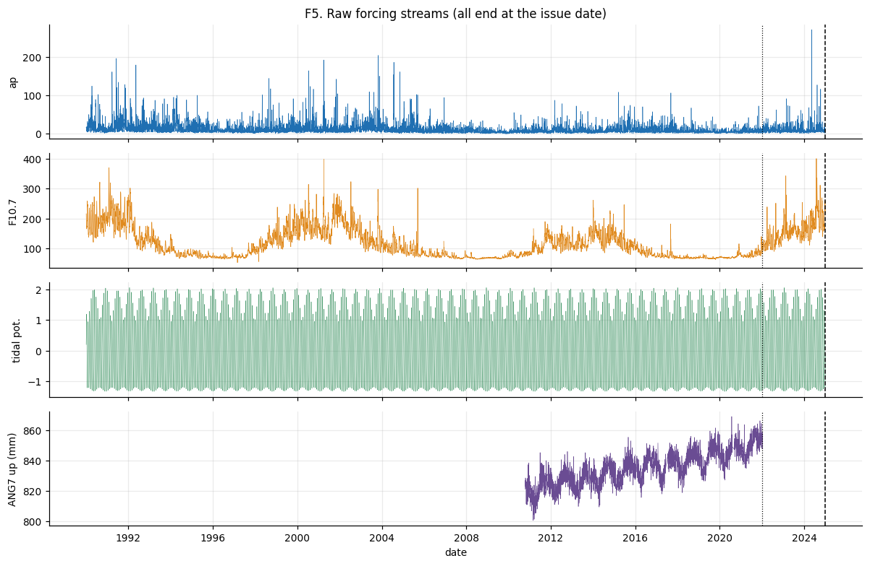
THE FEATURE INVENTORY
153 classical features, by family
Feature families and the class balance they must explain. Multi-radius × multi-window seismicity counts, magnitude and b-value statistics, ETAS intensity, recency and acceleration, distances to seismic zones, plus geomagnetic / solar / tidal / GPS windows.
Takeaway Good features encode domain knowledge: multi-scale counts (50/100/200 km × 7/30/90/365 days), physical rates, and distances. The model cannot invent these from raw numbers — you must build them.
Module 4 · Feature Engineering
Earthquake-Q · QuantathonV3
30
Notes:
153 classical features. Emphasize the multi-scale, physics-informed design.

Slide 31
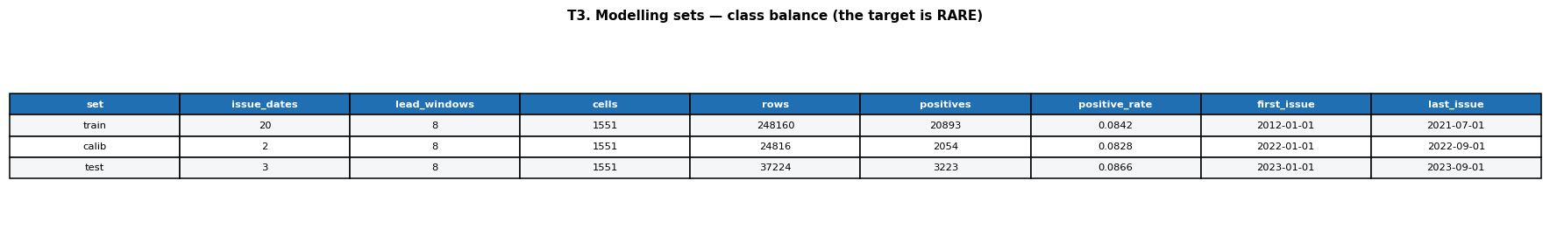
THE SUBTLE TRAP
Importance is not marginal value
Tree models report 'feature importance' by how often a feature helps split the data. That rewards any feature that helps the model identify which cell it is looking at.
GPS velocities, station distances, and zone distances are nearly constant per cell. A tree loves them — they are a perfect spatial fingerprint — so they score high importance.
But they add almost zero predictive value.
The model is using them to memorize per-cell base rates, not to forecast.
The reference measures each feature's temporal variance and ranks dynamic features by permutation importance — the honest measure of what actually helps out of sample.
Tree gain vs. how much a feature actually varies in time. High-gain, low-variance features (upper left) are spatial fingerprints — the model memorizing location, not forecasting.
Module 4 · Feature Engineering
Earthquake-Q · QuantathonV3
31
Notes:
Importance≠value is a top rubric item. Spatial fingerprints inflate importance without adding skill.

Slide 32
✓
HONESTY CHECKPOINT
Give the model physics; don't make it guess
A 250-feature tree, asked to rediscover ETAS from raw counts, overfits and generalizes worse than the five-parameter physics model.
The fix: hand the ETAS forecast to the ML as a feature.
The reference feeds each cell-window's fitted ETAS probability in as an input, and even boosts on top of it (physics as the starting point, trees learn only the residual correction).
Now the ML cannot lose to physics by ignorance — at worst it reproduces ETAS, at best it nudges it. This is 'physics-informed ML' done concretely.
“Asking a 373-feature GBM to rediscover ETAS is a losing game. Start boosting at the physics, and let the trees learn only the correction.”
Notes:
Physics-informed ML: etas_phys as a feature, plus the etas_boosted offset trick.

Slide 33
TRY IT YOURSELF · 4.1
Design features and audit them
The task
Propose three seismicity features at different spatial/temporal scales. For each, state what physical signal it captures.
You find that 'distance to nearest GPS station' has the 3rd-highest tree importance. Give the two-step test that decides whether it carries real predictive value.
Explain how you would feed a fitted ETAS forecast into a gradient-boosted model so the model is guaranteed not to do worse than ETAS out of the box.
Hints
Vary radius (50/100/200 km) and window (7/30/90/365 d). Counts, rates, and their acceleration are all distinct signals.
Compare tree gain to permutation importance on held-out data; and check whether the feature varies in time within a cell.
Work this before turning the page. The answer key is at the end of the module.
Module 4 · Feature Engineering
Earthquake-Q · QuantathonV3
33
Notes:
Exercise 4.1 covers feature design and the importance-vs-value audit.

Slide 34
ANSWER KEY · MODULE 4
Check your work
4.1 — three multi-scale features
e.g. 30-day count within 50 km (recent local activity / aftershock pressure); 365-day count within 200 km (regional background rate); acceleration = short-window rate ÷ long-window rate (is activity ramping up?).
4.1 — the two-step value test
Step 1: compare permutation importance (on held-out data) to tree gain — a big gap means the gain was in-sample memorization. Step 2: measure the feature's temporal variance within a cell — near-zero variance means it is a static spatial fingerprint. If both flags fire, it has high importance and ~zero marginal value.
4.1 — feeding ETAS into a GBM
Compute logit(ETAS) per row and pass it as the model's init_score (base margin). Boosting then starts at the physics prediction and adds trees only for the residual. Worst case the trees add nothing and you reproduce ETAS; you can never lose to it by ignorance.
Module 4 · Feature Engineering
Earthquake-Q · QuantathonV3
34
Notes:
Module 4 answer key.

Slide 35
5
MODULE 5
Validation & Calibration
The part that separates the top teams from everyone else.
IN THIS MODULE
Why calibration matters more than accuracy here
Isotonic calibration, and why you fit it on held-out data
Reading a reliability diagram
Clipping: why a forecast must never assert certainty

Slide 36
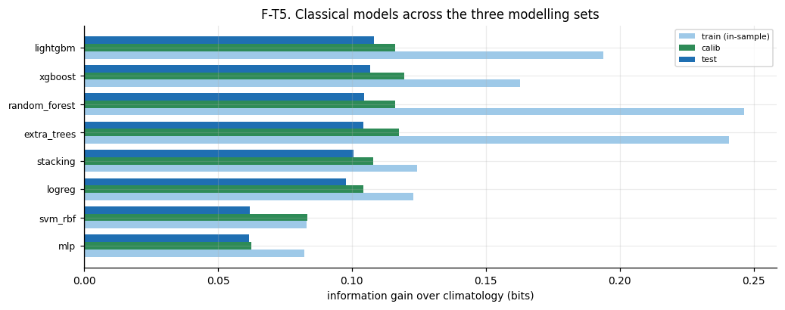
THE REAL SKILL
Calibration: are your probabilities true?
A forecast is calibrated if, among all the cell-windows where you said 20%, close to 20% actually had an earthquake.
This is different from ranking (AUC) and different from accuracy. A model can rank perfectly and still be wildly overconfident.
We measure it with Expected Calibration Error (ECE)
— the average gap between stated probability and observed frequency. The reference achieves ECE < 0.01.
In an operational forecast, calibration is the whole ballgame: an emergency manager needs 30% to mean 30%.
Reliability diagram (left) and sharpness (right). Points on the diagonal are perfectly calibrated; the histogram shows the model makes confident, well-spread predictions rather than hugging the base rate.
Module 5 · Validation & Calibration
Earthquake-Q · QuantathonV3
36
Notes:
Calibration is the separator. ECE < 0.01. Reliability diagram = stated vs observed.

Slide 37
HOW TO CALIBRATE
Isotonic regression, fit on held-out data
Raw model scores are rarely calibrated. Isotonic regression fixes that: it learns a monotone mapping from raw score to true frequency.
The critical rule: fit the calibrator on a held-out calibration set, never on the training data.
Calibrate on the data you trained on and you will look perfectly calibrated in-sample and fail in the field — the same leakage disease in a new place.
The reference reserves dedicated calibration dates, fits isotonic there, and evaluates on still-later dates and the sealed judge set.
1 · Train
Fit the model on training dates only.
2 · Calibrate
Fit isotonic regression on separate, later calibration dates.
3 · Evaluate
Score on still-later test dates, then the sealed judge window.
Module 5 · Validation & Calibration
Earthquake-Q · QuantathonV3
37
Notes:
Isotonic calibration on held-out data. Three separated stages. Never calibrate on training scores.

Slide 38
✓
HONESTY CHECKPOINT
A forecast must never say 0% or 100%
The log-loss scoring rule is unforgiving: assert probability 0 for something that then happens, and your score is negative infinity. One confident error can dominate everything.
So every prediction is clipped away from 0 and 1 (to [10⁻⁴, 1−10⁻⁴]).
This is not a numerical hack — it is a forecasting principle. An honest forecaster of a complex system never claims certainty.
In the reference run, an uncalibrated neural net scored −0.235 bits on the blind window — worse than useless — precisely because it made overconfident errors. Clipping and calibration are what stand between you and that fate.
“An operational forecast never asserts certainty. One confident mistake, and the log score buries you.”
Notes:
Clipping + the MLP disaster (−0.235 bits) drive home why overconfidence is fatal under log-loss.

Slide 39
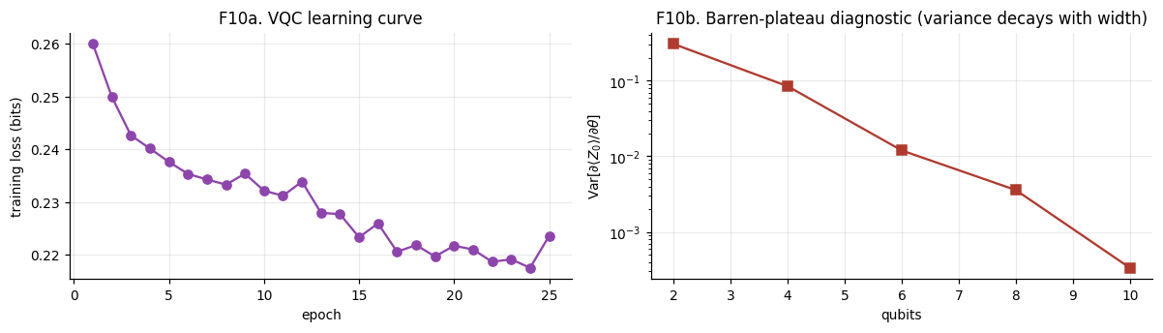
SKILL OVER TIME
Does the forecast survive 15 months out?
Information gain and AUC by lead window. A genuinely skillful forecast should hold its edge across the 30-day windows; a model that only memorized the recent past would decay quickly.
Takeaway Reporting skill as a function of lead time is more honest than a single pooled number — and it reveals whether your model actually uses the lead-window information it was given.
Module 5 · Validation & Calibration
Earthquake-Q · QuantathonV3
39
Notes:
Skill-vs-lead is an honesty tool: shows whether the forecast is genuinely time-dependent.

Slide 40
TRY IT YOURSELF · 5.1
Calibrate and diagnose
The task
Your model has AUC 0.88 but ECE 0.14. In plain language, what is wrong with it, and will isotonic calibration change its AUC?
You have training dates, and you need to both calibrate and honestly evaluate. How do you split your remaining dates, and why in that order?
A teammate clips predictions to [0.01, 0.99] 'to be safe' but fits the isotonic calibrator on the training scores. Which of the two safeguards is real, and which is theater?
Hints
AUC depends only on ranking; isotonic regression is monotone.
Overconfidence with good ranking is exactly the ECE-high, AUC-high case.
Work this before turning the page. The answer key is at the end of the module.
Module 5 · Validation & Calibration
Earthquake-Q · QuantathonV3
40
Notes:
Exercise 5.1 tests the calibration workflow and the difference between ranking and calibration.

Slide 41
ANSWER KEY · MODULE 5
Check your work
5.1 — AUC 0.88, ECE 0.14
It ranks well but its probabilities are dishonest — badly overconfident or underconfident. Isotonic calibration is monotone, so it will not change the AUC at all; it only remaps the probabilities to be truthful, driving ECE down. Ranking and calibration are independent axes.
5.1 — how to split the dates
Reserve the earliest dates for training, a middle block of later dates for calibration (fit isotonic here), and the latest dates for evaluation. Temporal order matters: calibrate and evaluate on data later than training, mirroring deployment. Never calibrate on training scores.
5.1 — real safeguard vs theater
Clipping to [0.01, 0.99] is a real (if crude) safeguard against catastrophic log-loss. Fitting isotonic on training scores is theater — it will look beautifully calibrated in-sample and fail out of sample. Calibration is only meaningful on held-out data.
Module 5 · Validation & Calibration
Earthquake-Q · QuantathonV3
41
Notes:
Module 5 answer key.

Slide 42
6
MODULE 6
Quantum Methods
Four ways to put a forecasting problem on a quantum computer — and how to test them honestly.
IN THIS MODULE
Encoding classical features into quantum states
Quantum feature maps and the 220 quantum features
Two quantum kernels — and why one concentrates to uselessness
Variational classifiers, and the barren-plateau wall

Slide 43
THE STARTING POINT
How do you put data on a qubit?
A quantum model needs classical numbers loaded into a quantum state. The workhorse is angle encoding: each feature becomes a rotation angle on a qubit.
|ψ(x)⟩ = ⊗ᵢ RY(xᵢ)|0⟩
Feature x₁ rotates qubit 1, x₂ rotates qubit 2, and so on. Entangling gates (CNOTs) then let the qubits interact, creating correlations no single feature holds.
You cannot encode 153 features into 10 qubits directly.
You must choose which features to load — and that choice is where many teams can go wrong; what will you do?
Angle encoding
Each feature → a qubit rotation. Simple, differentiable, hardware-friendly.
Entanglement
CNOT ladders/rings mix qubits so the state holds feature correlations.
Read-out
Measure Pauli-Z / ZZ expectation values → new 'quantum features' for a classical model.
Module 6 · Quantum Methods
Earthquake-Q · QuantathonV3
43
Notes:
Angle encoding + entanglement + expectation-value readout. The feature-selection bottleneck is the key practical issue.

Slide 44
✓
HONESTY CHECKPOINT
Encode dynamics, not location
With only ~10 qubits you must pick which features to encode. The naive choice — rank by tree importance — loads the spatial fingerprints (GPS, distances) we exposed in Module 4.
That wastes every qubit on memorizing location, which a lookup table already does for free.
The reference instead measures temporal variance, keeps only features that actually change over time, and ranks those by permutation importance. The encoded set becomes ETAS intensity, recent mean magnitude, seismicity counts — the dynamics.
The quantum circuit should spend its scarce qubits on what moves, not on where you are.
“21 of 152 features are near-static spatial fingerprints. Encoding those into a quantum circuit wastes every qubit on a location lookup.”
Notes:
The encoder-selection lesson connects Module 4's trap directly to quantum practice.

Slide 45
APPROACH 1
Quantum feature maps: 220 new features
The simplest useful quantum model isn't a classifier at all — it's a feature generator.
Encode the chosen features through several entangling circuits ('ansätze'), measure a battery of Pauli expectation values, and hand those numbers to your classical model as extra columns.
The reference builds 220 quantum features from 4 ansätze, for 373 features total.
This is the friendliest on-ramp: if the quantum features carry signal, your classical model's score rises. If they don't, it doesn't. Clean, testable, honest.
4 ansätze
Different entanglement patterns (ring, ladder, IQP-style) probe different correlations.
220 features
Pauli-Z and ZZ expectation values read from the encoded states.
Testable
Compare classical-only vs classical+quantum. The difference is the quantum contribution — measured, not assumed.
Module 6 · Quantum Methods
Earthquake-Q · QuantathonV3
45
Notes:
Quantum-features-as-columns is the most practical approach and the one that makes honest testing easy.

Slide 46
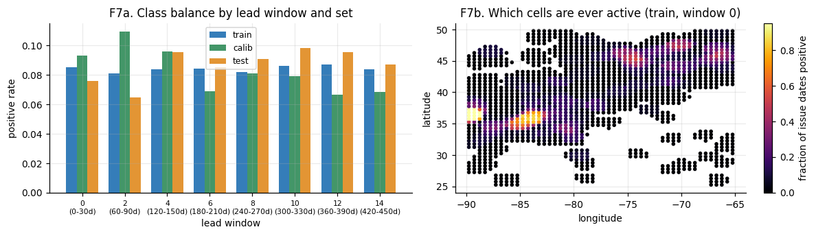
APPROACH 2
Quantum kernels — and a failure mode
A quantum kernel measures similarity between two data points by the overlap of their quantum states — then feeds that into a classical SVM.
The fidelity kernel: K(x,x') = |⟨ψ(x)|ψ(x')⟩|²
Its failure mode — exponential concentration:
as qubits increase, all off-diagonal similarities collapse toward zero. Every point looks equally dissimilar to every other, and the kernel becomes an identity matrix that teaches the SVM nothing.
The reference measures this directly and adds a projected kernel (using Bloch-vector distances) to sidestep it.
Fidelity-kernel concentration: off-diagonal entries shrink toward zero as the circuit grows. A kernel where nothing resembles anything is a kernel that cannot classify.
Module 6 · Quantum Methods
Earthquake-Q · QuantathonV3
46
Notes:
Fidelity kernel concentration is a real, measurable quantum-ML pathology. Projected kernel is the workaround.

Slide 47
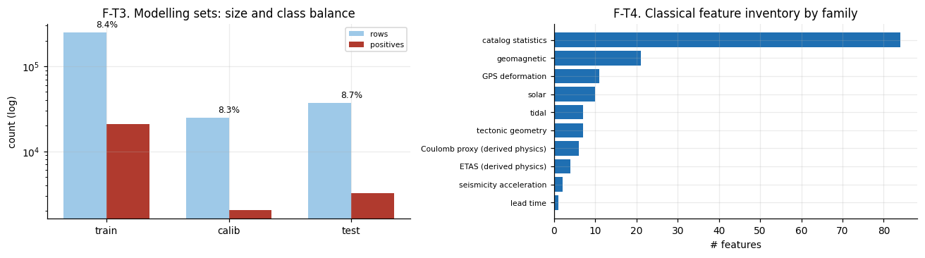
APPROACH 3
The Variational Quantum Classifier (VQC)
A VQC is a quantum circuit with trainable rotation angles, optimized like a neural network to output a class probability.
Encode the features, apply trainable layers, measure one qubit, map to a probability, and adjust the angles by gradient descent to minimize log-loss.
Two engineering lessons the reference learned the hard way:
(1) A bare ⟨Z⟩ readout is bounded in [−1,1] and cannot reach a 9% base rate — you need a trainable affine read-out. (2) Full-batch training stalls; mini-batches are essential.
VQC learning curve (left) and the barren-plateau diagnostic (right): gradient variance shrinking as qubits grow is the signature of the plateau.
Module 6 · Quantum Methods
Earthquake-Q · QuantathonV3
47
Notes:
VQC practical fixes: affine readout + mini-batches. The right panel previews barren plateaus.

Slide 48
THE WALL
Barren plateaus: why big VQCs won't train
As you add qubits, the gradient of a random variational circuit shrinks exponentially. The optimization landscape flattens into a vast plateau with no slope to follow.
The reference measures it: gradient variance falls 0.307 → 0.085 → 0.012 → 0.0036 → 0.0003 across 2, 4, 6, 8, 10 qubits.
That is a factor of ~1000 over eight qubits — a textbook exponential decay. Beyond a modest width, a generic VQC simply cannot be trained.
This is not a bug in your code. It is a known, fundamental limit — and knowing it exists is what separates informed quantum practitioners from the rest.
The signature
Gradient variance ↓ exponentially with qubit count. ~1000× over 8 qubits here.
Why it happens
Random deep circuits concentrate measure; expectation gradients average to ~0.
What to do
Shallow circuits, structured ansätze, smart initialization — or accept the width limit honestly.
Module 6 · Quantum Methods
Earthquake-Q · QuantathonV3
48
Notes:
Barren plateaus are THE fundamental scaling limit. The real gradient-variance numbers make it concrete.

Slide 49
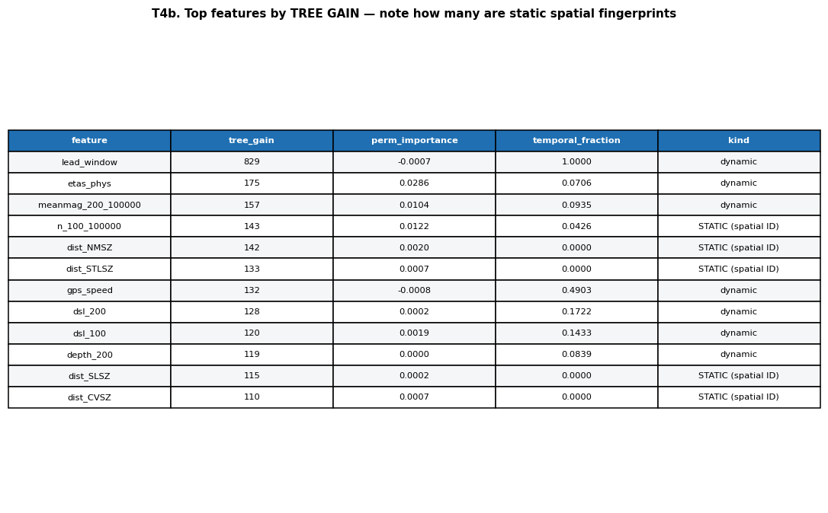
THE HONEST QUANTUM VERDICT
Does quantum actually help? Measure it.
Paired significance test, classical vs. classical+quantum, on the blind window: ΔAUC +0.0011, 95% CI [−0.0004, +0.0026] — spanning zero. Verdict: no statistically significant quantum lift.
Takeaway The quantum features are used by the model, but add no reliable generalization. Reporting that honestly — with a paired test and a confidence interval — is the mark of a top team, not a failure.
Module 6 · Quantum Methods
Earthquake-Q · QuantathonV3
49
Notes:
The quantum null result, measured rigorously. This is the honesty payoff for the whole quantum module.

Slide 50
TRY IT YOURSELF · 6.1
Reason about quantum models
The task
You have 152 features and 10 qubits. Describe your feature-selection strategy for the encoder, and justify why you would NOT just take the top-10 by tree importance.
Your quantum-kernel SVM performs at chance. You measure the kernel matrix and its off-diagonal entries are all ≈ 0. Name the phenomenon and one fix.
You add qubits to your VQC hoping for more power, but training gets worse and the loss barely moves. What is happening, and what is the diagnostic you would compute to confirm it?
Hints
Tree importance rewards static spatial fingerprints. What should a scarce qubit encode instead?
Off-diagonal kernel entries collapsing to zero has a specific name from Module 6.
Work this before turning the page. The answer key is at the end of the module.
Module 6 · Quantum Methods
Earthquake-Q · QuantathonV3
50
Notes:
Exercise 6.1 tests the three quantum pathologies: encoder choice, kernel concentration, barren plateaus.

Slide 51
ANSWER KEY · MODULE 6
Check your work
6.1 — encoder feature selection
Measure each feature's temporal variance within a cell; discard near-static ones (they are spatial fingerprints). Rank the remaining dynamic features by permutation importance on held-out data, and encode the top ~10. Top-10-by-tree-importance would load GPS/distance fingerprints, wasting qubits on location the model can memorize classically.
6.1 — kernel at chance, off-diagonals ≈ 0
Exponential kernel concentration: as the circuit grows, fidelities between distinct points collapse toward zero, giving a near-identity kernel that carries no similarity structure. Fixes: use fewer qubits / a shallower map, reduce the encoding angle scale, or switch to a projected (Bloch-vector) kernel.
6.1 — VQC gets worse with more qubits
Barren plateau: gradient variance decays exponentially with qubit count, flattening the landscape so the optimizer has no slope to follow. Diagnostic: sample random parameters and measure the variance of a gradient component across several qubit counts — an exponential decrease confirms the plateau.
Module 6 · Quantum Methods
Earthquake-Q · QuantathonV3
51
Notes:
Module 6 answer key.

Slide 52
7
MODULE 7
The Honest Verdict
The whole tournament comes down to one question, answered honestly.
IN THIS MODULE
The full leaderboard on the sealed judge window
Does a 373-feature pipeline beat 5-parameter physics?
AUC drawn as an area you can see

Slide 53
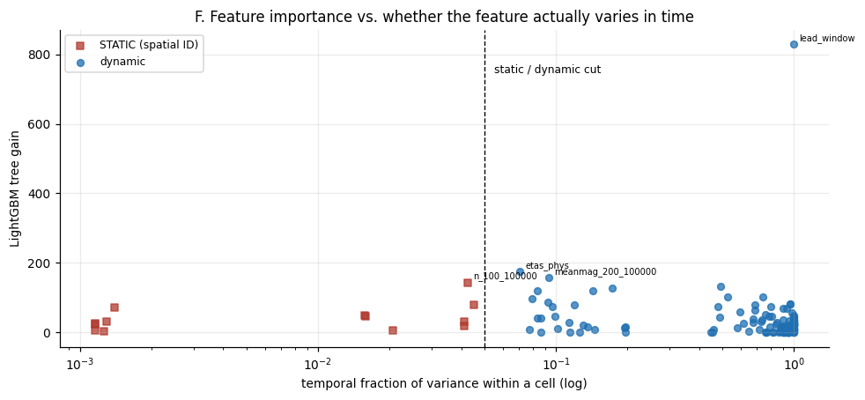
THE RESULT
Every model, on data none of them saw
Train / test / blind information gain for every model. The ranking on test largely survives on the blind window — which is exactly what a non-leaking pipeline looks like.
Takeaway Notice the gaps. The tree models overfit train IG to ~0.19–0.25 but score ~0.13 blind. ETAS shows almost no gap — it never saw the labels, so it has nothing to overfit.
Module 7 · The Honest Verdict
Earthquake-Q · QuantathonV3
53
Notes:
The all-sets comparison. The overfit gap is the story: trees overfit, physics doesn't.

Slide 54
THE HEADLINE
Parity with five parameters of physics
+0.136
+0.002
0.872
+0.001
Reference IG over climatology (bits), blind window
Reference IG over a fitted ETAS — statistical parity
Blind AUC — high, because location is predictable
Quantum ΔAUC — CI spans zero, no lift
With 248,000 training rows and 373 features — classical and quantum — the reference beats a five-parameter ETAS model by two thousandths of a bit. That is the honest result. A properly fitted physics baseline, which never saw a single label, is essentially as good as everything else combined.
Module 7 · The Honest Verdict
Earthquake-Q · QuantathonV3
54
Notes:
The four headline numbers. +0.136 over climatology, +0.002 over ETAS, 0.872 AUC, no quantum lift.

Slide 55
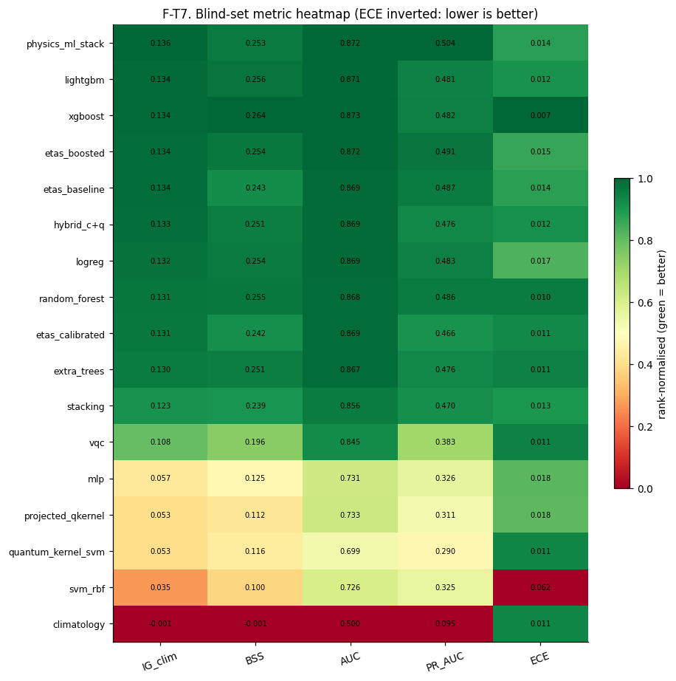
SEE THE SCORE
AUC, drawn as an area
AUC is literally an area — the area under the ROC curve. These panels shade it so you can read the score off the picture.
The grey wedge behind each curve is the no-skill region a coin flip earns (AUC 0.5). The colored area on top is what the model actually added.
Seeing the models overlaid this way makes the punchline visual: the physics baseline (green) and the full pipeline (red) enclose almost the same area. The quantum models enclose less.
A picture like this defends your result better than a table of decimals ever will.
AUC as a shaded area for each model on the blind window. The grey wedge is the no-skill baseline; the colored region is the earned skill.
Module 7 · The Honest Verdict
Earthquake-Q · QuantathonV3
55
Notes:
AUC-as-area makes the parity result visual and intuitive for a mixed audience.

Slide 56
✓
HONESTY CHECKPOINT
The honest negative is the winning answer
It is tempting to report the biggest margin you can find. Resist it. On this problem, a large margin over ETAS almost always means you leaked.
The team that reports 'our sophisticated pipeline achieves parity with five-parameter physics, and here is the evidence' has understood the problem better than the team claiming a spectacular win.
The reference selected its model on the test window (etas_boosted), and a different model won on the blind window (physics_ml_stack) — by 0.002 bits. With margins that thin, that is honest selection under uncertainty, not a mistake. Say so.
Science rewards the true answer, not the impressive one.
“A team that matches ETAS honestly, with clean calibration and no leakage, is already a top tier.
Notes:
The thesis of the entire deck, stated plainly. This is the checkpoint that matters most.

Slide 57
TRY IT YOURSELF · 7.1
Interpret the leaderboard
The task
Model A: train IG 0.25, blind IG 0.11. Model B: train IG 0.12, blind IG 0.13. Which do you trust more, and what does each gap tell you?
Your pipeline beats ETAS by 0.05 bits on the blind window. Before celebrating, what is the FIRST thing you should suspect, and how would you check it?
Explain to a skeptical judge why 'no statistically significant quantum lift' is a stronger scientific result than 'quantum improved AUC by 0.03' with no confidence interval.
Hints
A large train-minus-blind gap is the fingerprint of overfitting or leakage.
On this problem, ETAS is very strong. A large margin over it is surprising — and surprising results on held-out-looking data are usually leaks.
Work this before turning the page. The answer key is at the end of the module.
Module 7 · The Honest Verdict
Earthquake-Q · QuantathonV3
57
Notes:
Exercise 7.1 tests leaderboard literacy and scientific skepticism.

Slide 58
ANSWER KEY · MODULE 7
Check your work
7.1 — Model A vs Model B
Trust B. A's huge train-to-blind gap (0.25 → 0.11) signals overfitting: it memorized the training set. B generalizes cleanly (0.12 → 0.13), even improving out of sample, which is the signature of an honest, well-regularized model. On this problem the small honest gap beats the large one.
7.1 — beating ETAS by 0.05 bits
Suspect leakage first. A 0.05-bit margin over a properly fitted ETAS is implausibly large. Check: does any feature use post-issue information? Is the label window disjoint from the feature window? Is CV temporal, not shuffled? Re-run with strict temporal separation and see if the margin survives.
7.1 — why the honest negative is stronger
A claim without a confidence interval is unfalsifiable noise — 0.03 AUC could easily be sampling variation. 'No significant lift, CI spans zero, from a paired test' is a rigorous, reproducible statement about what the data support. Quantifying uncertainty, including when it dooms your favored hypothesis, is what makes it science.
Module 7 · The Honest Verdict
Earthquake-Q · QuantathonV3
58
Notes:
Module 7 answer key.

Slide 59
8
MODULE 8
The Naive Control
What if you skip the physics entirely and just pour raw data into a model?
IN THIS MODULE
The control experiment every team should run
How far three inputs (lat, lon, lead) can take you
Quantifying the value of feature engineering and physics
The stationarity caveat that keeps everyone honest

Slide 60
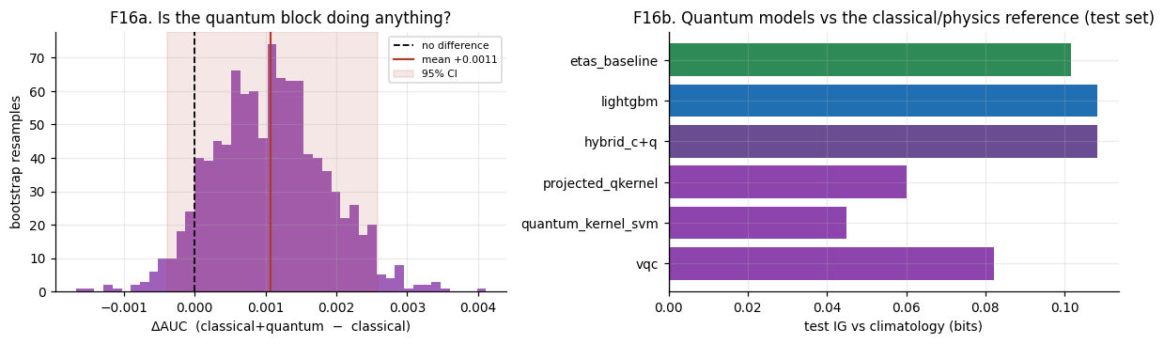
THE CONTROL
Raw numbers, straight into a model
Here is the experiment that anchors the whole result: do the minimum to make a design matrix — no counting, no distances, no windows, no physics — and let a model suite loose on the raw numbers.
This is exactly what an unaided AI pipeline produces. The gap between it and the engineered reference is the measured value of feature engineering. The gap to ETAS is the value of physics.
A ladder from L0 (just lat, lon, lead-window) to L4 (adding raw sequences, events, and GPS) shows what each addition of raw data actually buys.
The no-feature-engineering ladder and its own overfitting. Raw data alone gets remarkably far; the honest control against which sophistication must justify itself.
Module 8 · The Naive Control
Earthquake-Q · QuantathonV3
60
Notes:
The naive control is the pedagogical centerpiece and the answer to the user's specific request.

Slide 61
THE SURPRISE
Three inputs get you most of the way
93%
+0.016
+0.010
of the reference's information gain, from just lat, lon, lead-window
bits — the measured value of all feature engineering
bits — the measured value of ETAS physics
A model with three inputs — where the cell is, and how far ahead — reaches blind IG +0.124 and AUC 0.854. It has memorized where earthquakes happen, from the same cells it is scored on. Feature engineering adds ~0.016 bits on top; physics adds ~0.010. That is the whole challenge in three numbers: locating the active zones is most of the battle, and the sophisticated machinery earns a real but modest margin.
Module 8 · The Naive Control
Earthquake-Q · QuantathonV3
61
Notes:
The killer result: 3 inputs = 93% of the reference. Feature engineering and physics are the marginal ~7%.

Slide 62
✓
HONESTY CHECKPOINT
Don't over-credit the spatial prior
The three-input model's skill is a pure spatial prior: it learns which cells host quakes, from the same grid it is scored on. That is legitimate and non-leaking — but it only transfers as far as seismicity is stationary.
On this dataset, the per-cell rank correlation between the training era and the blind window is only ~0.49 — moderate, not high. About 55% of blind events fall in the top-20 training cells.
So the naive model wins on this 15-month window but would degrade over a longer horizon or a shifting catalog — which is precisely where engineered features and physics earn their margin.
A strong team makes this point without being prompted: the spatial prior wins cheaply and temporarily, and here is the evidence for when it won't.
“Locating the active zones is ~93% of the achievable information. A team whose pipeline doesn't clearly beat that has rediscovered the central result.”
Notes:
The stationarity caveat (ρ≈0.49) turns 'spatial prior wins' into the more sophisticated, defensible version.

Slide 63
TRY IT YOURSELF · 8.1
Run the control in your head
The task
Why is a three-input (lat, lon, lead) model NOT leaking, even though it scores well on cells it 'saw' in training?
The naive ladder goes L0 → L1 by adding six raw geophysical numbers, and the blind IG DROPS. Explain why adding real data made the model worse.
Given that raw data alone captures ~93% of the reference's skill, argue both sides: (a) feature engineering was a waste; (b) feature engineering was essential. Which side is right, and under what conditions?
Hints
Distinguish memorizing a stationary spatial pattern from using future information.
Six unaggregated daily numbers vs. a strong spatial prior — what does the model do with pure noise?
Work this before turning the page. The answer key is at the end of the module.
Module 8 · The Naive Control
Earthquake-Q · QuantathonV3
63
Notes:
Exercise 8.1 makes teams reason about the control's meaning and limits.

Slide 64
ANSWER KEY · MODULE 8
Check your work
8.1 — why 3 inputs don't leak
It uses only static coordinates and the lead window — no event-derived, post-issue information exists in the feature set. Its skill is a spatial prior (which cells are active), learned from history and applied forward. That is legitimate memorization of a stationary pattern, not leakage of the future.
8.1 — why adding raw data hurt
Six unaggregated daily indices (ap, Kp, F10.7, etc.) carry almost no cell-level forecasting signal, but they add noise and free parameters the model can overfit. Without aggregation into physical features, the extra columns dilute the strong spatial prior — so blind IG falls. Raw ≠ useful.
8.1 — was feature engineering worth it?
Both are partly right. On this short, spatially-stationary blind window, the spatial prior dominates and engineering adds only ~0.016 bits — looks marginal. But over longer horizons or a shifting catalog the prior degrades (ρ≈0.49), and engineered/physics features are what remain. Engineering buys robustness and transfer, not headline points on an easy window. That is the honest verdict.
Module 8 · The Naive Control
Earthquake-Q · QuantathonV3
64
Notes:
Module 8 answer key.

Slide 65
9
MODULE 9
Deploy & Reflect
A real forecast for a real city — and the lessons you take home.
IN THIS MODULE
An operational forecast for Charleston, SC, with honest uncertainty
The five findings a strong submission reproduces
A checklist you can apply to any forecasting problem
Where to go next

Slide 66
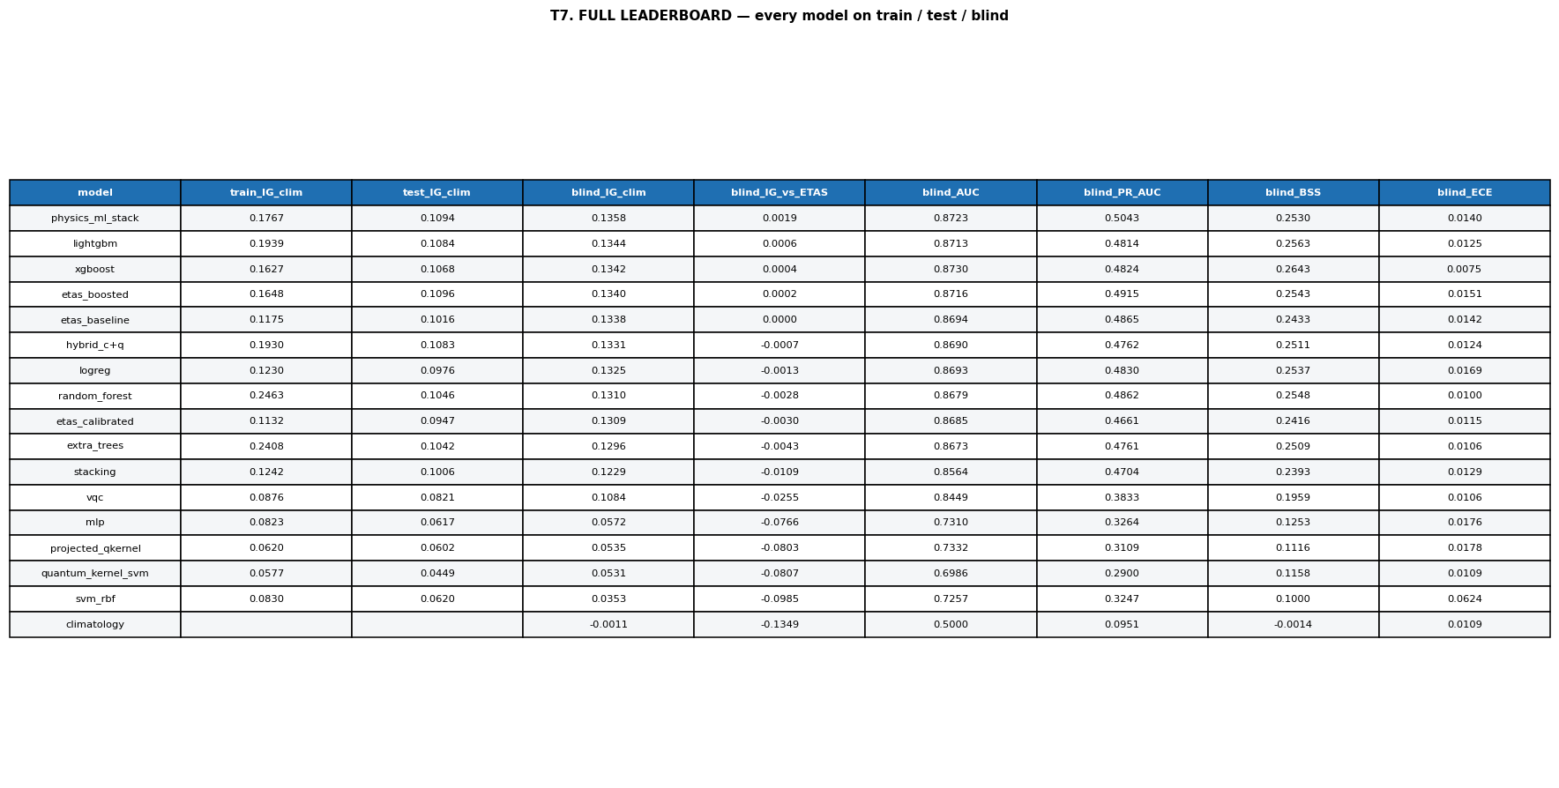
DEPLOYMENT
A real forecast, with honest error bars
The operational forecast for Charleston, SC, across all 15 windows, with a bootstrap uncertainty band on the first window. Green stripes mark windows where a qualifying earthquake actually occurred.
Takeaway The deliverable is not a leaderboard number — it is a calibrated probability an emergency manager could act on, with its uncertainty stated honestly and its probabilities clipped away from false certainty.
Module 9 · Deploy & Reflect
Earthquake-Q · QuantathonV3
66
Notes:
Charleston forecast: the human-facing deliverable. Uncertainty stated, certainty never claimed.

Slide 67
THE FIVE FINDINGS
What a strong submission reproduces
1 · Parity with ETAS
4 · Calibration > accuracy
A 373-feature pipeline beats 5-parameter physics by only ~0.002 bits.
A high-AUC, poorly-calibrated model is a failing forecast. ECE is the real test.
2 · No quantum lift
5 · α ≈ 0 → decluster
Quantum features are used but add no significant generalization (CI spans 0).
The ETAS pathology reveals catalog contamination — a real seismological task.
3 · Spatial prior ≈ 93%
The meta-lesson
Three inputs capture most of the achievable information gain.
Honesty, quantified with confidence intervals, beats an impressive-looking margin every time.
Module 9 · Deploy & Reflect
Earthquake-Q · QuantathonV3
67
Notes:
The five findings double as the judges' expected-results checklist. A team hitting these understood the problem.

Slide 68
TAKE IT ANYWHERE
A checklist for any forecasting problem
Define the target precisely — units, horizon, and what counts as a hit.
Score on a proper rule (log-loss / information gain), not accuracy.
Build a strong, simple baseline first — and respect it.
Train the way you will be scored; match the deployment distribution.
Separate train, calibration, and evaluation in time. Never shuffle time series.
Calibrate on held-out data; report ECE, not just AUC.
Distinguish feature importance from marginal value.
Quantify uncertainty — and believe it, even when it kills your favorite idea.
If you remember one thing
A simple, well-understood baseline you can defend beats a complex model you cannot.
If you remember two
Calibration and leakage control decide real forecasts. Everything else is a rounding error.
If you remember three
Report the true result, with its confidence interval — especially if it is not the result you hoped for; discuss path forwards
Module 9 · Deploy & Reflect
Earthquake-Q · QuantathonV3
68
Notes:
The portable checklist — the deck's transferable value beyond this one competition.

Slide 69
The point was never the leaderboard
You now know how to build an honest forecast: define the target, respect the baseline, control leakage, calibrate, and quantify what you actually know.
That skill outlasts any one competition — and any one hardware generation.
Everything in this deck — the code, the data, the figures, and every number — is real and reproducible.
EARTHQUAKE-Q · QuantathonV3 · Clemson University
Notes:
Closing. The transferable skill — honest forecasting — is the real prize, and it outlasts the hardware.

Slide 70
DEEP DIVES
Reference material & worked detail
Extra figures and explanations for a second, deeper pass. Read these once you have the arc.
Notes:
Transition into the deep-dive appendix: reference-grade detail for a second pass.

Slide 71
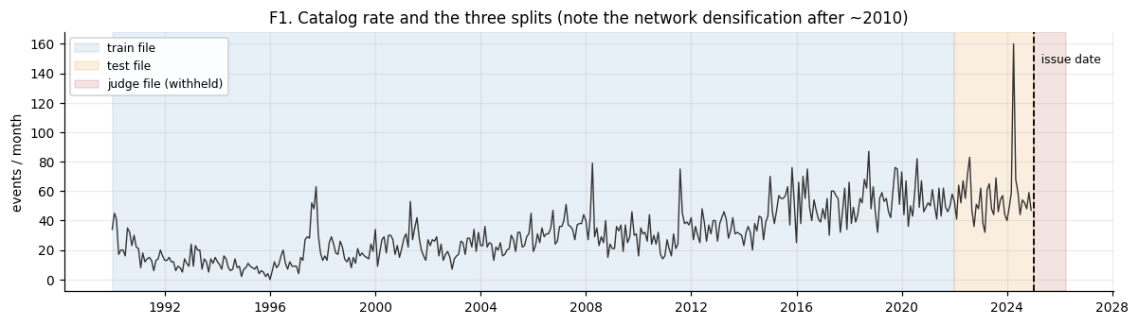
DATA · DEEP DIVE
The seismicity map you're forecasting
(Blind data set is now included in the challenge)
Epicenters across the central & eastern US. The active zones — New Madrid, Eastern Tennessee, the Charlevoix and Charleston areas — are visible by eye, which is exactly why a spatial prior is so powerful.
Takeaway Before any model, look at your data. If the structure is obvious to your eye, it will be obvious to a model — and 'obvious' skill is not the same as useful skill.
Deep dives
Earthquake-Q · QuantathonV3
71
Notes:
Spatial map. Grounds the whole problem in geography.

Slide 72
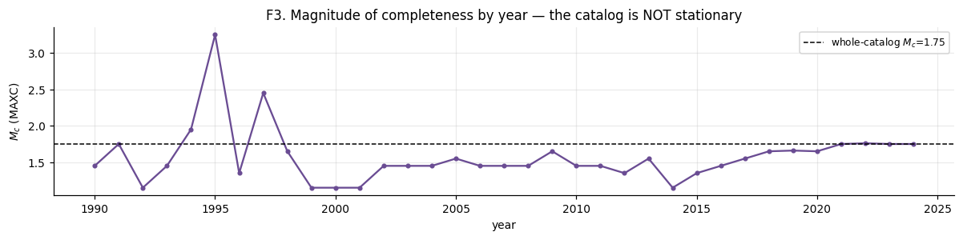
DATA · DEEP DIVE
Magnitude and depth distributions
Magnitude and depth histograms for the catalog. Most events are shallow and small; the magnitude histogram is the raw material behind the Gutenberg–Richter fit.
Takeaway Depth and magnitude distributions are sanity checks. An unexpected spike at a round-number depth, or a bump at a specific magnitude, often signals catalog artifacts worth investigating.
Deep dives
Earthquake-Q · QuantathonV3
72
Notes:
Mag-depth histograms as a data-quality check.

Slide 73
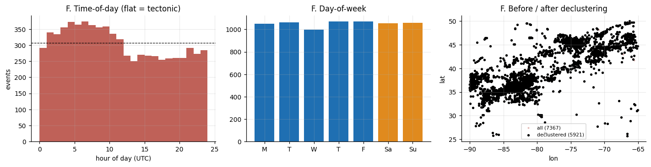
SEISMOLOGY · DEEP DIVE
Why finding the zones isn't enough
Target concentration: even within the active zones, most cell-windows are negative. Knowing where quakes cluster gets you a high AUC but leaves most of the information-gain on the table.
Takeaway Beating climatology requires more than a map of the active zones — it requires knowing when a given zone is elevated. That temporal signal is where ETAS and good features earn their keep.
Deep dives
Earthquake-Q · QuantathonV3
73
Notes:
Target concentration: spatial prior is necessary but not sufficient.

Slide 74
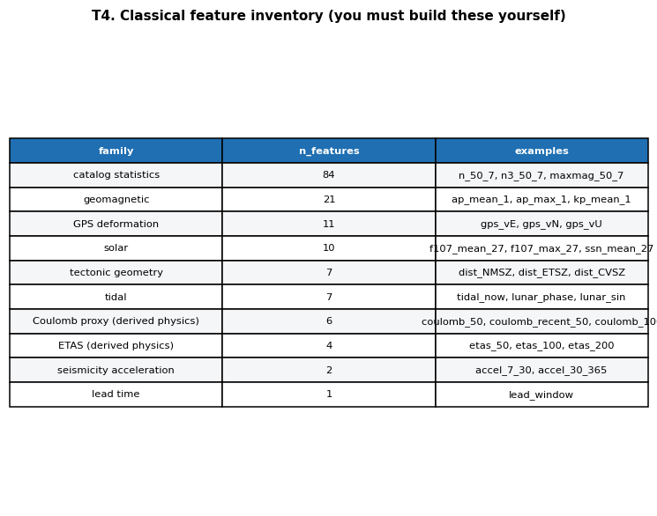
MODELING · DEEP DIVE
Classical models, head to head
Information gain for each classical model across train, calibration, and test. Gradient-boosted trees (LightGBM, XGBoost) lead; the gap between train and test exposes each model's overfitting.
Takeaway Boosted trees are the workhorse for tabular forecasting. But read the train-to-test gap, not just the test number — a model that overfits train is telling you how it will behave on the blind set.
Deep dives
Earthquake-Q · QuantathonV3
74
Notes:
Classical leaderboard. Boosted trees win; watch the overfit gap.

Slide 75
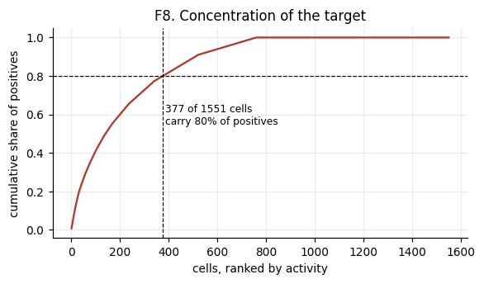
MODELING · DEEP DIVE
Every method on one axis
All models — classical, quantum, hybrid, and physics — on the test set. Color-coded by family. The physics and best-classical models cluster at the top; quantum-only models trail.
Takeaway Put every approach on one honest axis. When the quantum-only models sit visibly below the classical and physics models, that is data, not opinion — and it is the result you should report.
Deep dives
Earthquake-Q · QuantathonV3
75
Notes:
All-models bar chart. Quantum-only trails; physics leads.

Slide 76
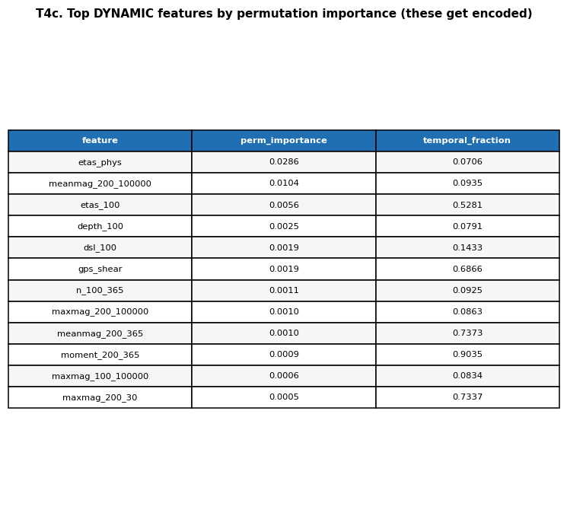
MODELING · DEEP DIVE
The blind-window scorecard
Heatmap of every model against every metric on the sealed judge window (calibration error inverted so green is always better). The top rows are physics and physics-informed ML; they win on nearly every metric at once.
Takeaway A single metric can be gamed; a full scorecard cannot. When one row is green across the board, you can trust it — and here the green rows are built on physics.
Deep dives
Earthquake-Q · QuantathonV3
76
Notes:
Blind heatmap: multi-metric view, physics on top.

Slide 77
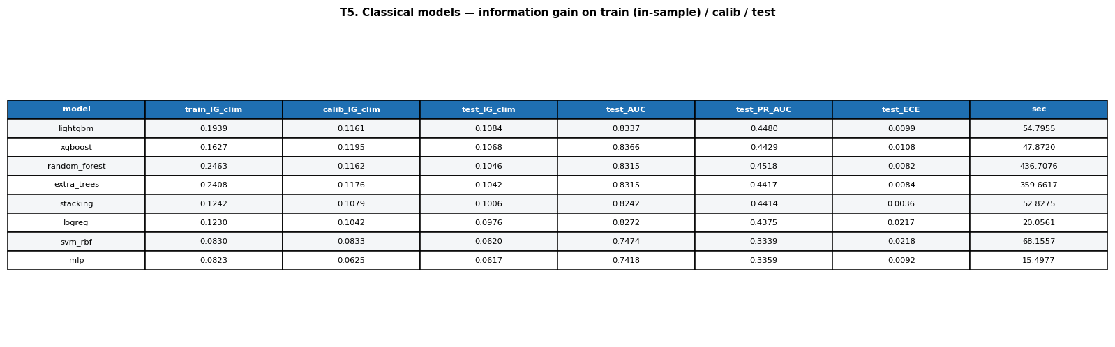
VALIDATION · DEEP DIVE
ROC and precision–recall, blind window
ROC and precision–recall curves on the blind window. PR is the more honest view for a rare target: the base rate is ~9.5%, so the precision axis starts low and every gain is hard-won.
Takeaway For rare events, precision–recall tells you more than ROC. A model can look great on ROC and still flood an operator with false alarms — PR is where that shows up.
Deep dives
Earthquake-Q · QuantathonV3
77
Notes:
ROC vs PR; PR is the honest view for rare positives.

Slide 78
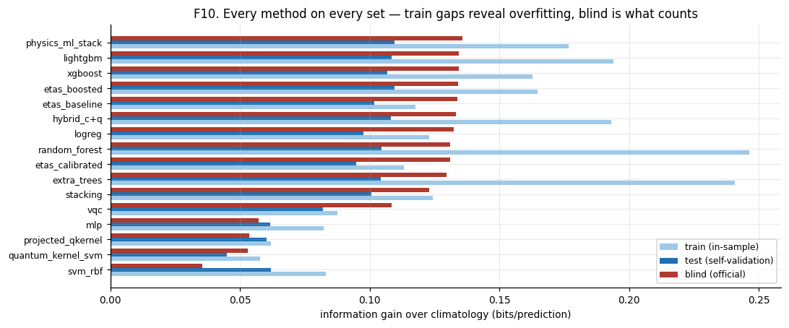
VALIDATION · DEEP DIVE
AUC as an area, overlaid
Each model's ROC area drawn over the reference's shaded area. The lift a challenger must earn is the sliver of extra area above the reference — and on this problem that sliver is thin.
Takeaway This is the single most honest picture in the deck: the 'better' models add only a sliver of area over a five-parameter physics baseline. See it, and the parity result is undeniable.
Deep dives
Earthquake-Q · QuantathonV3
78
Notes:
AUC overlay: the thin sliver of improvement over physics, made visual.

Slide 79
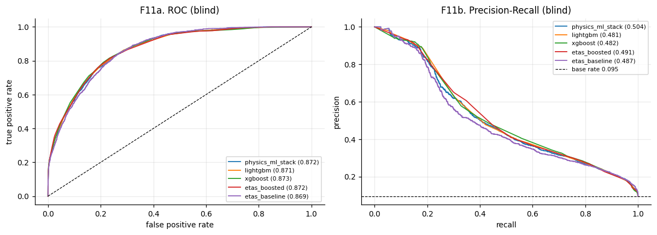
VALIDATION · DEEP DIVE
Does skill survive to window 15?
AUC drawn as an area for early, middle, and late lead windows. If the shaded area shrank sharply with lead time, the forecast would be riding only on recent memory; here it holds up reasonably across the horizon.
Takeaway Skill that survives 15 months out is a genuinely time-dependent forecast, not a snapshot of last month. Slicing the result by lead window is how you prove it.
Deep dives
Earthquake-Q · QuantathonV3
79
Notes:
AUC-area by lead window: proves time-dependence.

Slide 80
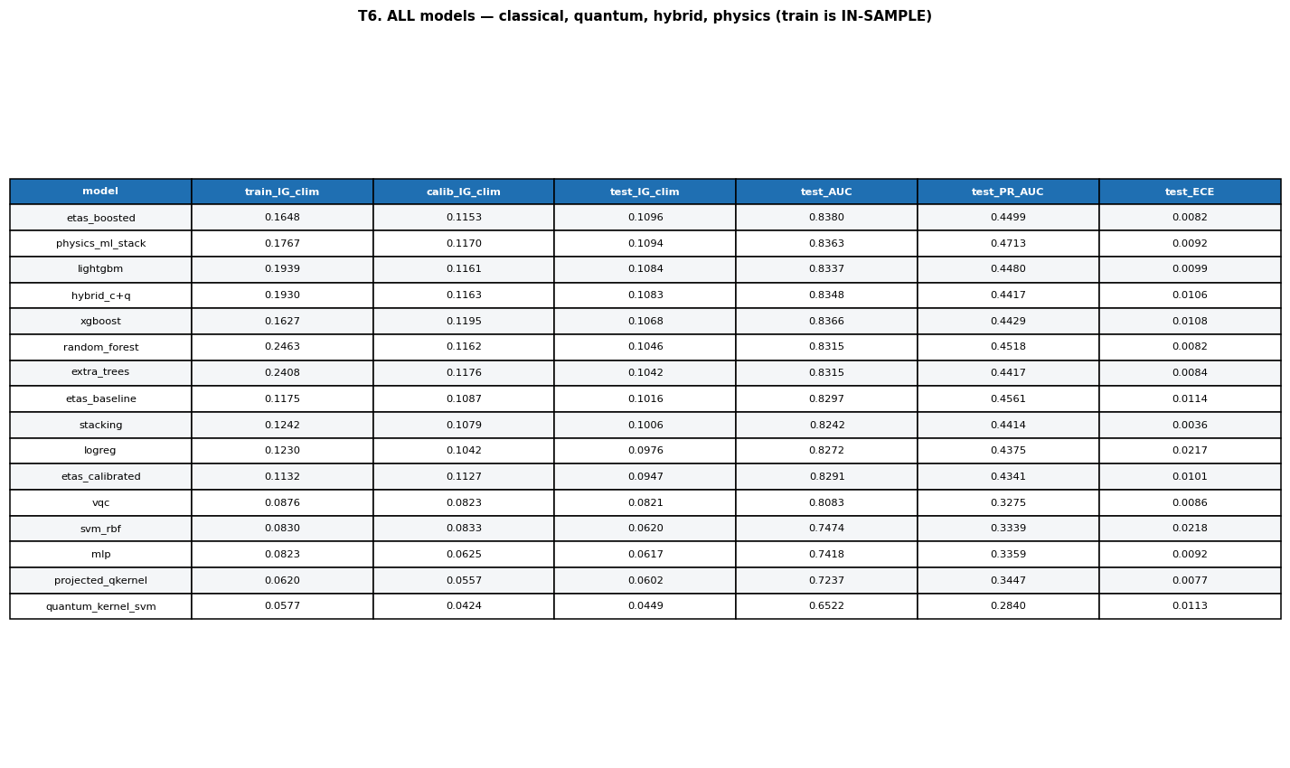
INTERPRETATION · DEEP DIVE
Where the predictive signal lives
Feature importance grouped by source. The seismic catalog and its derived quantum features dominate; geomagnetic, solar, tidal, and GPS streams contribute little.
Takeaway The catalog carries the signal. The other four streams are honest near-nulls — a finding to report, not a failure to hide. Importance here still needs the value audit from Module 4.
Deep dives
Earthquake-Q · QuantathonV3
80
Notes:
Feature-importance by source: catalog dominates.

Slide 81
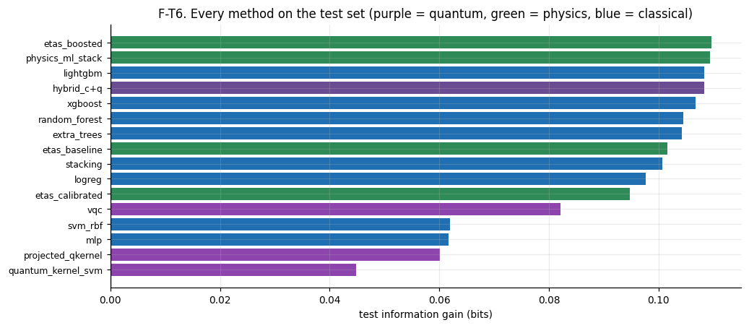
INTERPRETATION · DEEP DIVE
The source-ablation ladder
Marginal blind-window value of each raw stream, added one at a time to the same learner. Geomagnetic, solar, tidal, and GPS each move the score by hundredths of a bit or less — sometimes negative.
Takeaway Ablation is how you separate 'the model used it' from 'it actually helped'. Adding a stream that moves blind IG by −0.004 bits is evidence it should be dropped, not celebrated.
Deep dives
Earthquake-Q · QuantathonV3
81
Notes:
Source ablation: the four non-seismic streams are near-nulls.

Slide 82
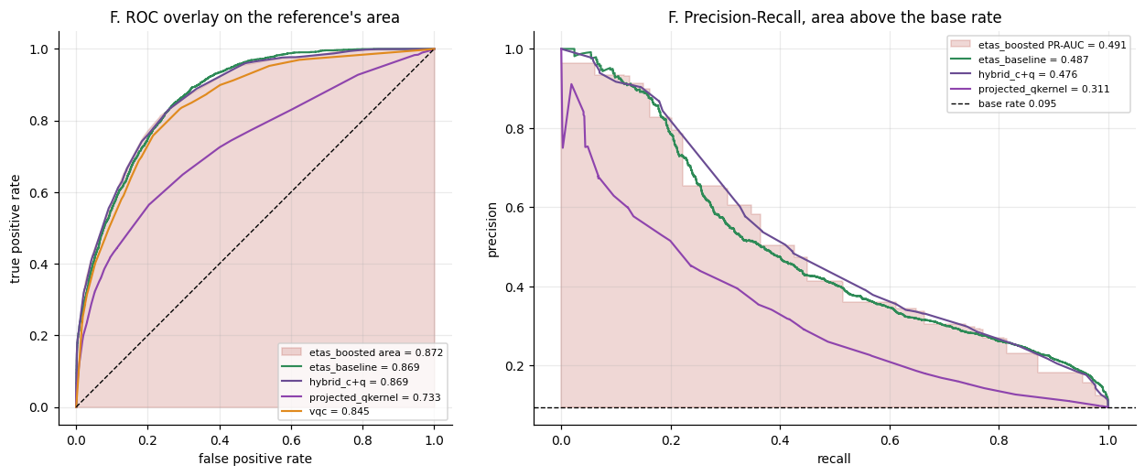
THE CONTROL · DEEP DIVE
The full value table
The bottom line, as a table: climatology → naive raw-data model → feature-engineered model → physics → reference. Each step's marginal gain in bits is spelled out.
Takeaway This one table is the entire challenge quantified. Print it, tape it above your desk, and remember: the biggest single jump is from nothing to a spatial prior — everything after is the hard-won margin.
Deep dives
Earthquake-Q · QuantathonV3
82
Notes:
The value table: the whole result in one artifact.

Slide 83
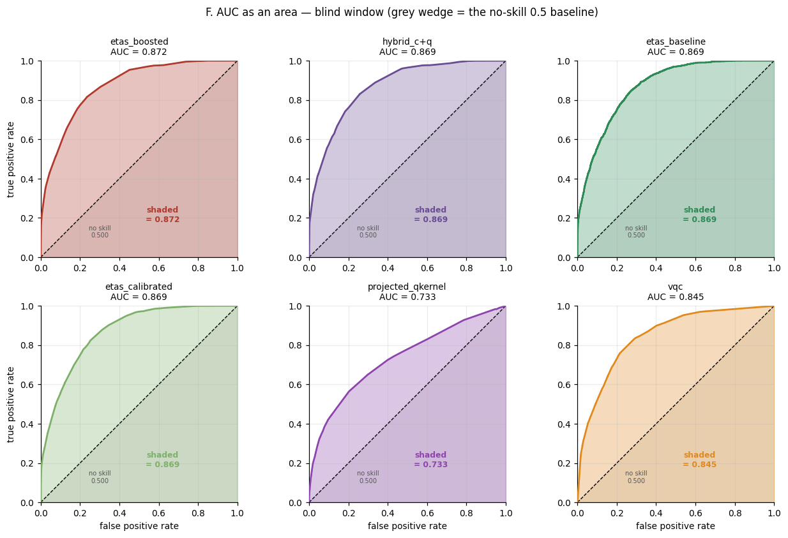
THE CONTROL · DEEP DIVE
The naive model suite
The full model suite on raw L4 inputs — no feature engineering. Boosted trees still lead; a logistic regression on raw numbers scores catastrophically negative, a reminder that the wrong model on raw data is worse than useless.
Takeaway Even in the no-engineering control, model choice matters enormously. The same raw data yields +0.12 bits (boosted trees) or −1.3 bits (naive logistic) depending only on the learner.
Deep dives
Earthquake-Q · QuantathonV3
83
Notes:
Naive suite: model choice matters even without features; logistic on raw data implodes.

Slide 84
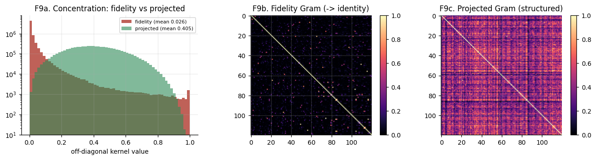
DEPLOYMENT · DEEP DIVE
The forecast as a map
The reference forecast rendered as a probability map for the first window. This is the artifact an emergency manager actually consumes — a calibrated risk surface, not a leaderboard row.
Takeaway The end product of all this machinery is a map someone can act on. Never lose sight of that: the metrics serve the forecast, not the other way around.
Deep dives
Earthquake-Q · QuantathonV3
84
Notes:
Forecast map: the human-facing deliverable, one more time.

Slide 85
TRY IT YOURSELF · Capstone
Put it all together
The task
You are handed the three CSVs with an example solution. Write the 8-step pipeline you would build, in order, from raw data to a calibrated, leakage-safe submission — naming the one baseline you must beat and the one metric you must minimize.
For each of the five headline findings (ETAS parity, no quantum lift, spatial prior ≈ 93%, calibration > accuracy, α ≈ 0), state in one sentence how you would demonstrate it from the data.
A rival team reports blind IG +0.28. You reported +0.135. Before conceding, what three things do you ask to see?
Hints
The 8 steps mirror the nine modules of this deck. Baseline = ETAS; metric = log-loss / maximize information gain.
+0.28 bits is more than half the theoretical entropy ceiling of ~0.45. What would that require?
Work this before turning the page. The answer key is at the end of the module.
Deep dives
Earthquake-Q · QuantathonV3
85
Notes:
Capstone exercise: synthesizes the entire deck. The +0.28 prompt tests the tripwire instinct.

Slide 86
ANSWER KEY · MODULE Capstone
Check your work
Capstone — the 8-step pipeline
1) Estimate Mc and b (get completeness right). 2) Fit ETAS by MLE — your baseline. 3) Build grid training rows, features strictly pre-issue. 4) Engineer multi-scale seismicity + ETAS features; feed ETAS as an input. 5) Split train/calibration/test in time. 6) Fit boosted trees; calibrate isotonic on held-out dates. 7) Clip predictions; measure IG and ECE vs climatology AND ETAS. 8) Forecast the blind grid, quantify uncertainty. Beat: ETAS. Minimize: log-loss (maximize information gain).
Capstone — demonstrating the five findings
ETAS parity: report IG-over-ETAS with a CI. No quantum lift: paired classical-vs-hybrid bootstrap, CI spanning 0. Spatial prior: run the 3-input control, compare IG. Calibration>accuracy: show a high-AUC model with high ECE failing on log-loss. α≈0: free ETAS fit plus the declustering diagnostic.
Capstone — rival claims +0.28 bits
Ask for: (1) their feature code, to check for post-issue information; (2) their validation scheme, to check for shuffled CV on spatiotemporal rows; (3) their train-vs-blind gap. +0.28 is >60% of the ~0.45-bit entropy ceiling — near-certainly leakage. The tripwire (blind IG > 0.20) exists for exactly this.
Deep dives
Earthquake-Q · QuantathonV3
86
Notes:
Capstone answer key: the whole deck, self-tested.

Slide 87
WORKED EXAMPLES
Three hard ideas, worked by hand
Follow the arithmetic once and the concept sticks. These mirror the code in the reference notebook.
Notes:
Three fully worked numeric examples for self-study.

Slide 88
WORKED EXAMPLE 1
Estimating the b-value from a catalog
1
Choose the completeness magnitude Mc so you only fit complete data.
Mc = 1.75
2
Keep only events with magnitude ≥ Mc, and compute their mean magnitude.
mean(m | m≥Mc) = 2.263
3
Apply the Aki maximum-likelihood estimator for the slope b.
b = log₁₀(e) / (m̄ − Mc)
= 0.4343 / (2.263 − 1.75)
4
Read the result and sanity-check it against the regional expectation (~0.8–1.0).
b = 0.4343 / 0.513 ≈ 0.846 ✓
Result b = 0.846 — physically sensible for the eastern US. Now imagine Mc were set too low at 1.45: the incomplete small events pull m̄ down toward Mc, the denominator shrinks, and b balloons past 1.1. That is why completeness comes first — b is exquisitely sensitive to it.
Worked examples
Earthquake-Q · QuantathonV3
88
Notes:
Worked b-value, numerically correct: m̄=2.263, Mc=1.75 → b=0.846. Shows sensitivity to Mc.

Slide 89
WORKED EXAMPLE 2
One ETAS forecast, by hand
1
Start from the fitted parameters (the reference's free-α MLE fit).
μ=0.109/day K=0.104
α=0.061 c=0.188d p=1.001
2
For a target cell-window, gather past events within range and their times/magnitudes.
events j: (tⱼ, mⱼ)
3
Sum each event's Omori-decayed, magnitude-weighted contribution over the 30-day window.
Λ_trig = Σⱼ K·e^{α(mⱼ−Mc)}·∫(t−tⱼ+c)^{−p}dt
4
Add the background and convert the expected count Λ to a probability.
P = 1 − e^{−(μ·30 + Λ_trig)}
Result P is a genuine, physics-based probability for that cell-window — no labels, no training. Do this for every cell and window and you have the ETAS baseline the whole tournament is measured against.
Worked examples
Earthquake-Q · QuantathonV3
89
Notes:
Worked ETAS: expected count → probability via 1−exp(−Λ). This is the baseline everything is measured against.

Slide 90
WORKED EXAMPLE 3
Computing information gain
1
Take a handful of cell-windows with your forecast p and the truth y (1=quake).
e.g. p=[.30,.05,.20], y=[1,0,0]
2
Compute your model's mean log-loss (lower is better).
L_model = −mean(y·ln p + (1−y)·ln(1−p))
3
Compute climatology's log-loss using the constant base rate for every p.
L_clim with p = 0.095 everywhere
4
Information gain is the reduction in log-loss, converted to bits.
IG = (L_clim − L_model) / ln(2)
Result A positive IG means your forecast carries real information beyond the base rate. The reference scores +0.136 bits vs climatology and +0.002 vs ETAS on the blind window — the numbers this whole deck has been building toward.
Worked examples
Earthquake-Q · QuantathonV3
90
Notes:
Worked IG: log-loss difference in bits. Connects the scoring rule to the headline numbers.

Slide 91
REFERENCE
Ten ways strong teams lose
✗
Optimizing AUC
✗
Under-estimating Mc
Ranking ≠ calibration. High AUC, useless forecast.
Biases b low; corrupts every physics feature.
✗
Shuffled cross-validation
✗
Event-centered training
Scatters neighbors across folds; CV ≫ blind.
Train/deploy mismatch vs the grid you're scored on.
✗
Skipping the ETAS baseline
✗
Calibrating on training data
You can't claim a win over a bar you never measured.
Looks perfect in-sample, fails in the field.
✗
Confusing importance with value
✗
Asserting 0% or 100%
Rewards spatial fingerprints, not skill.
One confident error and log-loss buries you.
✗
Chasing a big margin
✗
Reporting no uncertainty
A large win over ETAS almost always means leakage.
A number without a CI is not a scientific claim.
Reference
Earthquake-Q · QuantathonV3
91
Notes:
The ten-mistake gallery doubles as a pre-submission checklist.

Slide 92
REFERENCE
Glossary — the terms you'll meet (1/2)
Information Gain
Reduction in log-loss versus a reference, in bits. The core scoring metric.
Climatology
The historical base rate — the easy baseline every forecast must beat.
ETAS
Epidemic-Type Aftershock Sequence: a 5-parameter physics model of earthquake triggering.
Magnitude of completeness (Mc)
The magnitude above which a catalog records essentially all events.
b-value
Slope of the Gutenberg–Richter law; ~1.0 means small quakes greatly outnumber large.
Calibration (ECE)
Whether stated probabilities match observed frequencies; Expected Calibration Error measures the gap.
Reference
Earthquake-Q · QuantathonV3
92

Slide 93
REFERENCE
Glossary — the terms you'll meet (2/2)
Isotonic regression
A monotone mapping that recalibrates raw model scores to true frequencies.
Leakage
Future or held-out information contaminating features or validation. The silent killer.
Angle encoding
Loading a feature onto a qubit as a rotation angle — the basic quantum data-loading step.
Quantum kernel
Similarity between points measured by quantum-state overlap, fed to a classical SVM.
Barren plateau
Exponentially vanishing gradients that make large variational quantum circuits untrainable.
Permutation importance
Held-out feature value measured by shuffling; the honest counterpart to tree gain.
Reference
Earthquake-Q · QuantathonV3
93

Slide 94
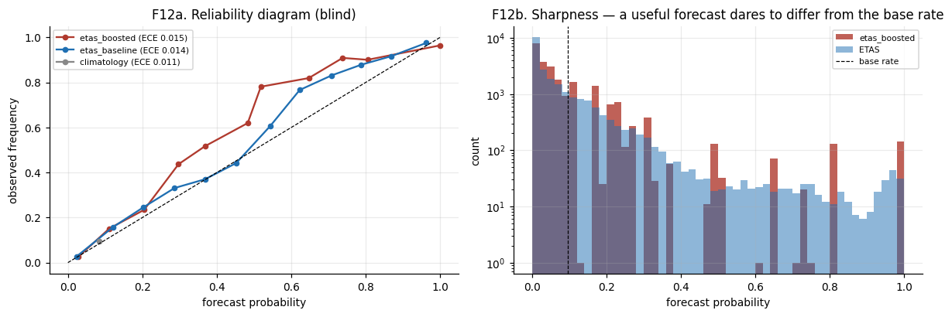
VALIDATION · DEEP DIVE
The leakage self-check, visualized
Two guards against fooling yourself: the test-vs-blind agreement (left) and the reliability of the final probabilities (right). When blind performance meets or exceeds the self-reported number, you have evidence you did not leak.
Takeaway The reference's self-reported test IG was +0.110 and its blind IG was +0.134 — the blind score went UP. A model that improves out of sample is the opposite of a leaking one.
Deep dives
Earthquake-Q · QuantathonV3
94
Notes:
Leakage check: blind ≥ test is the anti-leakage signature. Real numbers: test +0.110 → blind +0.134.

Slide 95
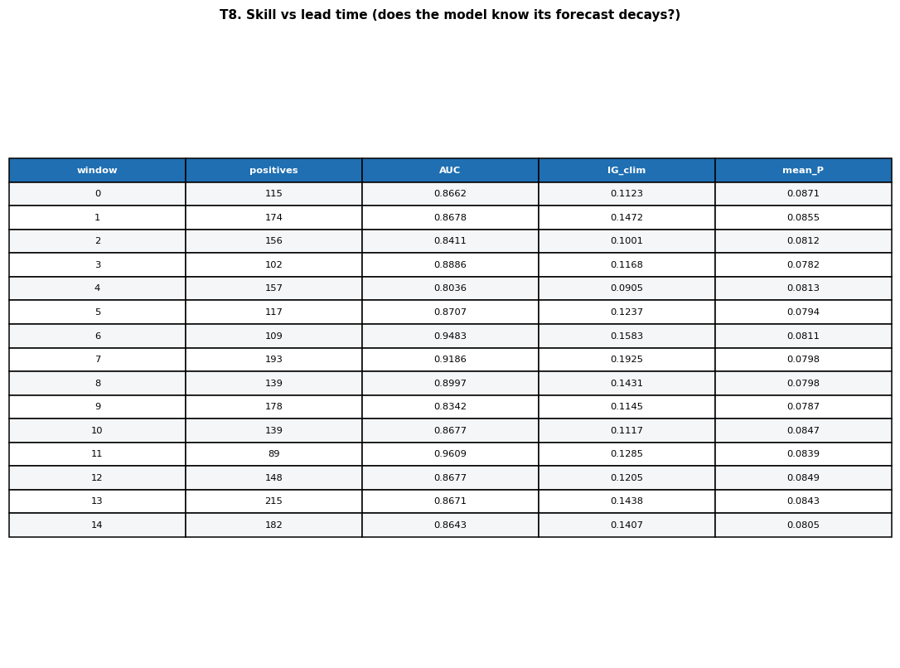
VALIDATION · DEEP DIVE
Skill, window by window
Information gain and event counts for each of the 15 lead windows. Windows with more activity carry more information; the forecast tracks the real variation rather than emitting a flat prior.
Takeaway A forecast that varies sensibly with the actual activity level — more confident when there is more to say — is behaving like a forecast, not a lookup table.
Deep dives
Earthquake-Q · QuantathonV3
95
Notes:
Per-window skill detail: the forecast tracks real activity variation.

Slide 96
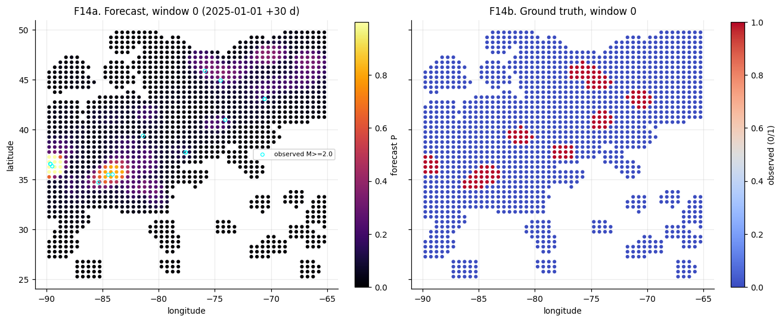
DEPLOYMENT · DEEP DIVE
Forecast vs. what actually happened
Side by side: the predicted probability surface and the observed events for a window. The forecast concentrates probability where events actually cluster — without ever having seen this window.
Takeaway Overlaying prediction and truth is the most honest self-assessment there is. If your high-probability cells and the real events don't visually coincide, no metric will save you.
Deep dives
Earthquake-Q · QuantathonV3
96
Notes:
Forecast vs truth map: the eyeball test for a probabilistic forecast.

Slide 97
TWO WAYS IN
Wherever you're starting from
If you're a quantum / CS person
This challenge was built to be humbling from every direction.
The pure ML team can learn that a five-parameter physics model matches their 373-feature pipeline. The pure physics team learns that rigorous calibration and honest uncertainty are their own discipline. The quantum enthusiast learns that measuring a null result is harder — and more valuable — than claiming a win.
Nobody walks in with all four skills. That is the point.
Read the whole deck once, then return to the two modules furthest from your comfort zone. That is where the learning is.
Your instinct is to reach for the most powerful model. Resist it. Spend your first time on Modules 3 and 5 — the physics baseline and calibration. The quantum content in Module 6 only matters once you can beat climatology honestly.
If you're a geoscientist
You already own the physics. Your growth edge is Modules 5 and 6 — rigorous validation and the quantum toolbox. Your ETAS baseline is your superpower; the challenge is proving ML adds anything to it.
Deep dives
Earthquake-Q · QuantathonV3
97
Notes:
The two-audience primer meets each participant where they are and points them at their growth edge.

Slide 98
ORIENTATION
How the reference notebook is built
Everything in this deck is implemented in one reference notebook, in two parts:
Part I — Data build (these are provided with the package; you do not need to refetch them).
If Fetched, it would fetch all five sources live, verify each with a SHA-256 hash, and write the three frozen CSVs plus a provenance file. You would run once (but you don’t have to)
Part II — Reference solution.
Completeness and ETAS fitting, feature engineering, the classical and quantum model suites, calibration, the naive control, and every figure in this deck.
A FAST/FULL switch lets you smoke-test the whole pipeline in minutes before committing to the multi-hour full run.
Reproducible
SEED = 42 throughout. Same inputs, same outputs, every run.
Provenance-first
Every CSV carries a hash. If the data changed, you'll know.
Honest by design
The naive control and significance tests are built in, not bolted on.
FAST / FULL
Prototype in minutes; produce the judged run in hours.
Deep dives
Earthquake-Q · QuantathonV3
98
Notes:
Orientation slide: how the reference notebook is structured, so participants can navigate the code.

Slide 99
WHERE TO GO NEXT
Keep going after the Quantathon
Re-fit ETAS after declustering the catalog — does α move toward its tectonic value?
Try a physics-informed neural net that respects the Omori decay law by construction.
Build a proper spatial cross-validation and see how much of the spatial-prior skill survives.
Test a structured, shallow quantum ansatz designed to avoid the barren plateau — can it beat the classical features on any slice?
Extend the forecast forward in time and score it prospectively, with no possibility of leakage.
Prepare journal article
The open questions are real
None of these have a settled answer on this dataset. A careful attempt at any one is a genuine contribution.
The skill transfers
Swap earthquakes for wildfires, floods, outages, or disease. The method — baseline, calibrate, control, quantify — is the same everywhere.
Deep dives
Earthquake-Q · QuantathonV3
99
Notes:
Next-steps slide: concrete research directions and the transferability message.

Slide 100
ONE CARD TO REMEMBER
The whole challenge, distilled
Target
P(M≥2 within 100 km, 30-day window) — a calibrated probability
Score
Information gain in bits vs climatology AND vs a fitted ETAS
Hard baseline
5-parameter ETAS: blind IG +0.134 over climatology
Reference result
+0.136 over climatology, only +0.002 over ETAS — parity
Quantum
Used, but no significant lift (ΔAUC CI spans 0)
Naive control
3 inputs → 93% of the reference's information gain
The lesson
Honesty, quantified, beats an impressive margin every time
Notes:
The single summary card — the entire challenge on one slide, for quick reference.

